Slide 1
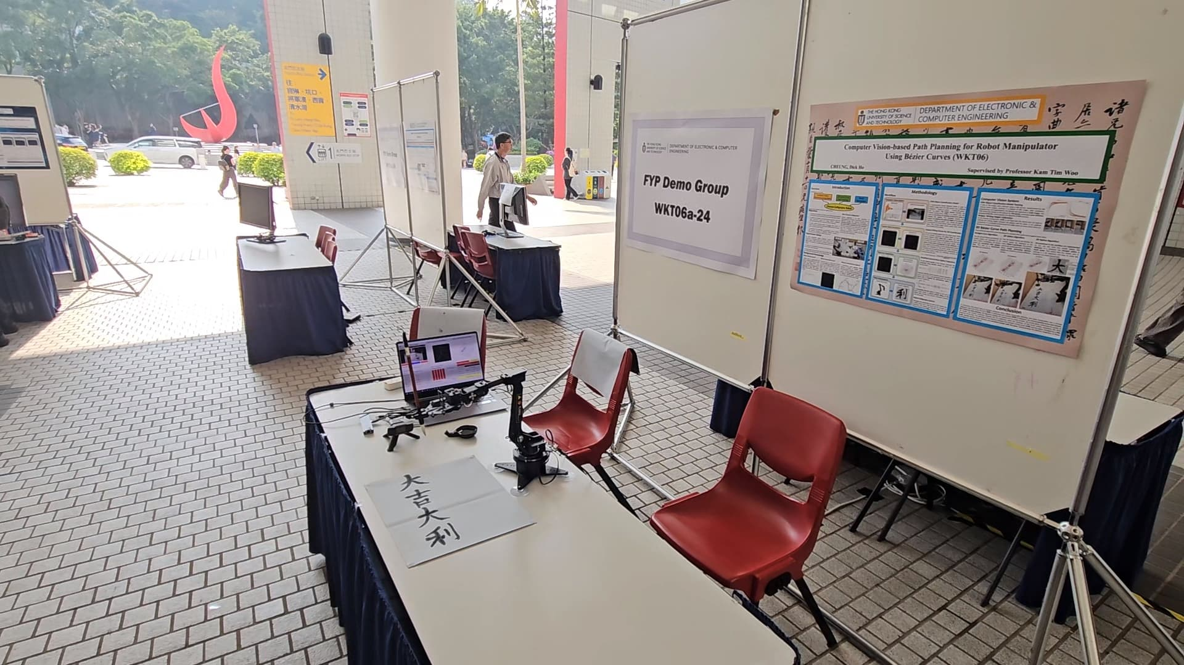
Computer Vision-based Path Planning for Robot Manipulator Using Bézier Curves
Bézier Curve
Computer Vision
CHEUNG Dick Ho (WKT06a-24)
Supervisor: Professor Tim Woo
Notes:
Good morning everyone, my name is Dicaprio and this is my FYP. Before I begin, I would like to re-title my FYP into Bezier Curve based Path Planning, for Robot Manipulator, Using Computer Vision. I realized that my original title is a bit confusing after the midterm poster presentation day, but it is a bit too late to change the title in Febuary.

Slide 2
TABLE OF CONTENTS
01
02
03
04
Project Objective
Methodology
Performance Evaluation
Video Demo
Notes:
(Skip)

Slide 3
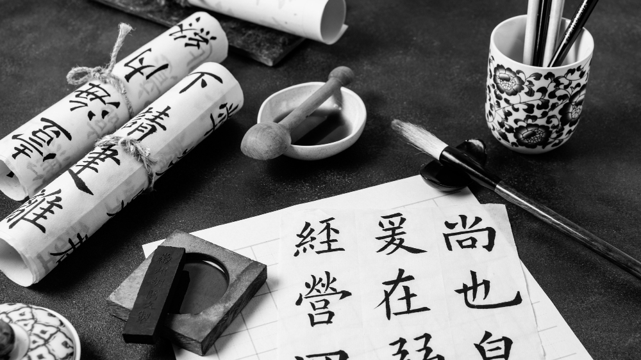
01
PROJECT OBJECTIVE
Why I did this project?
Notes:
(Skip)

Slide 4
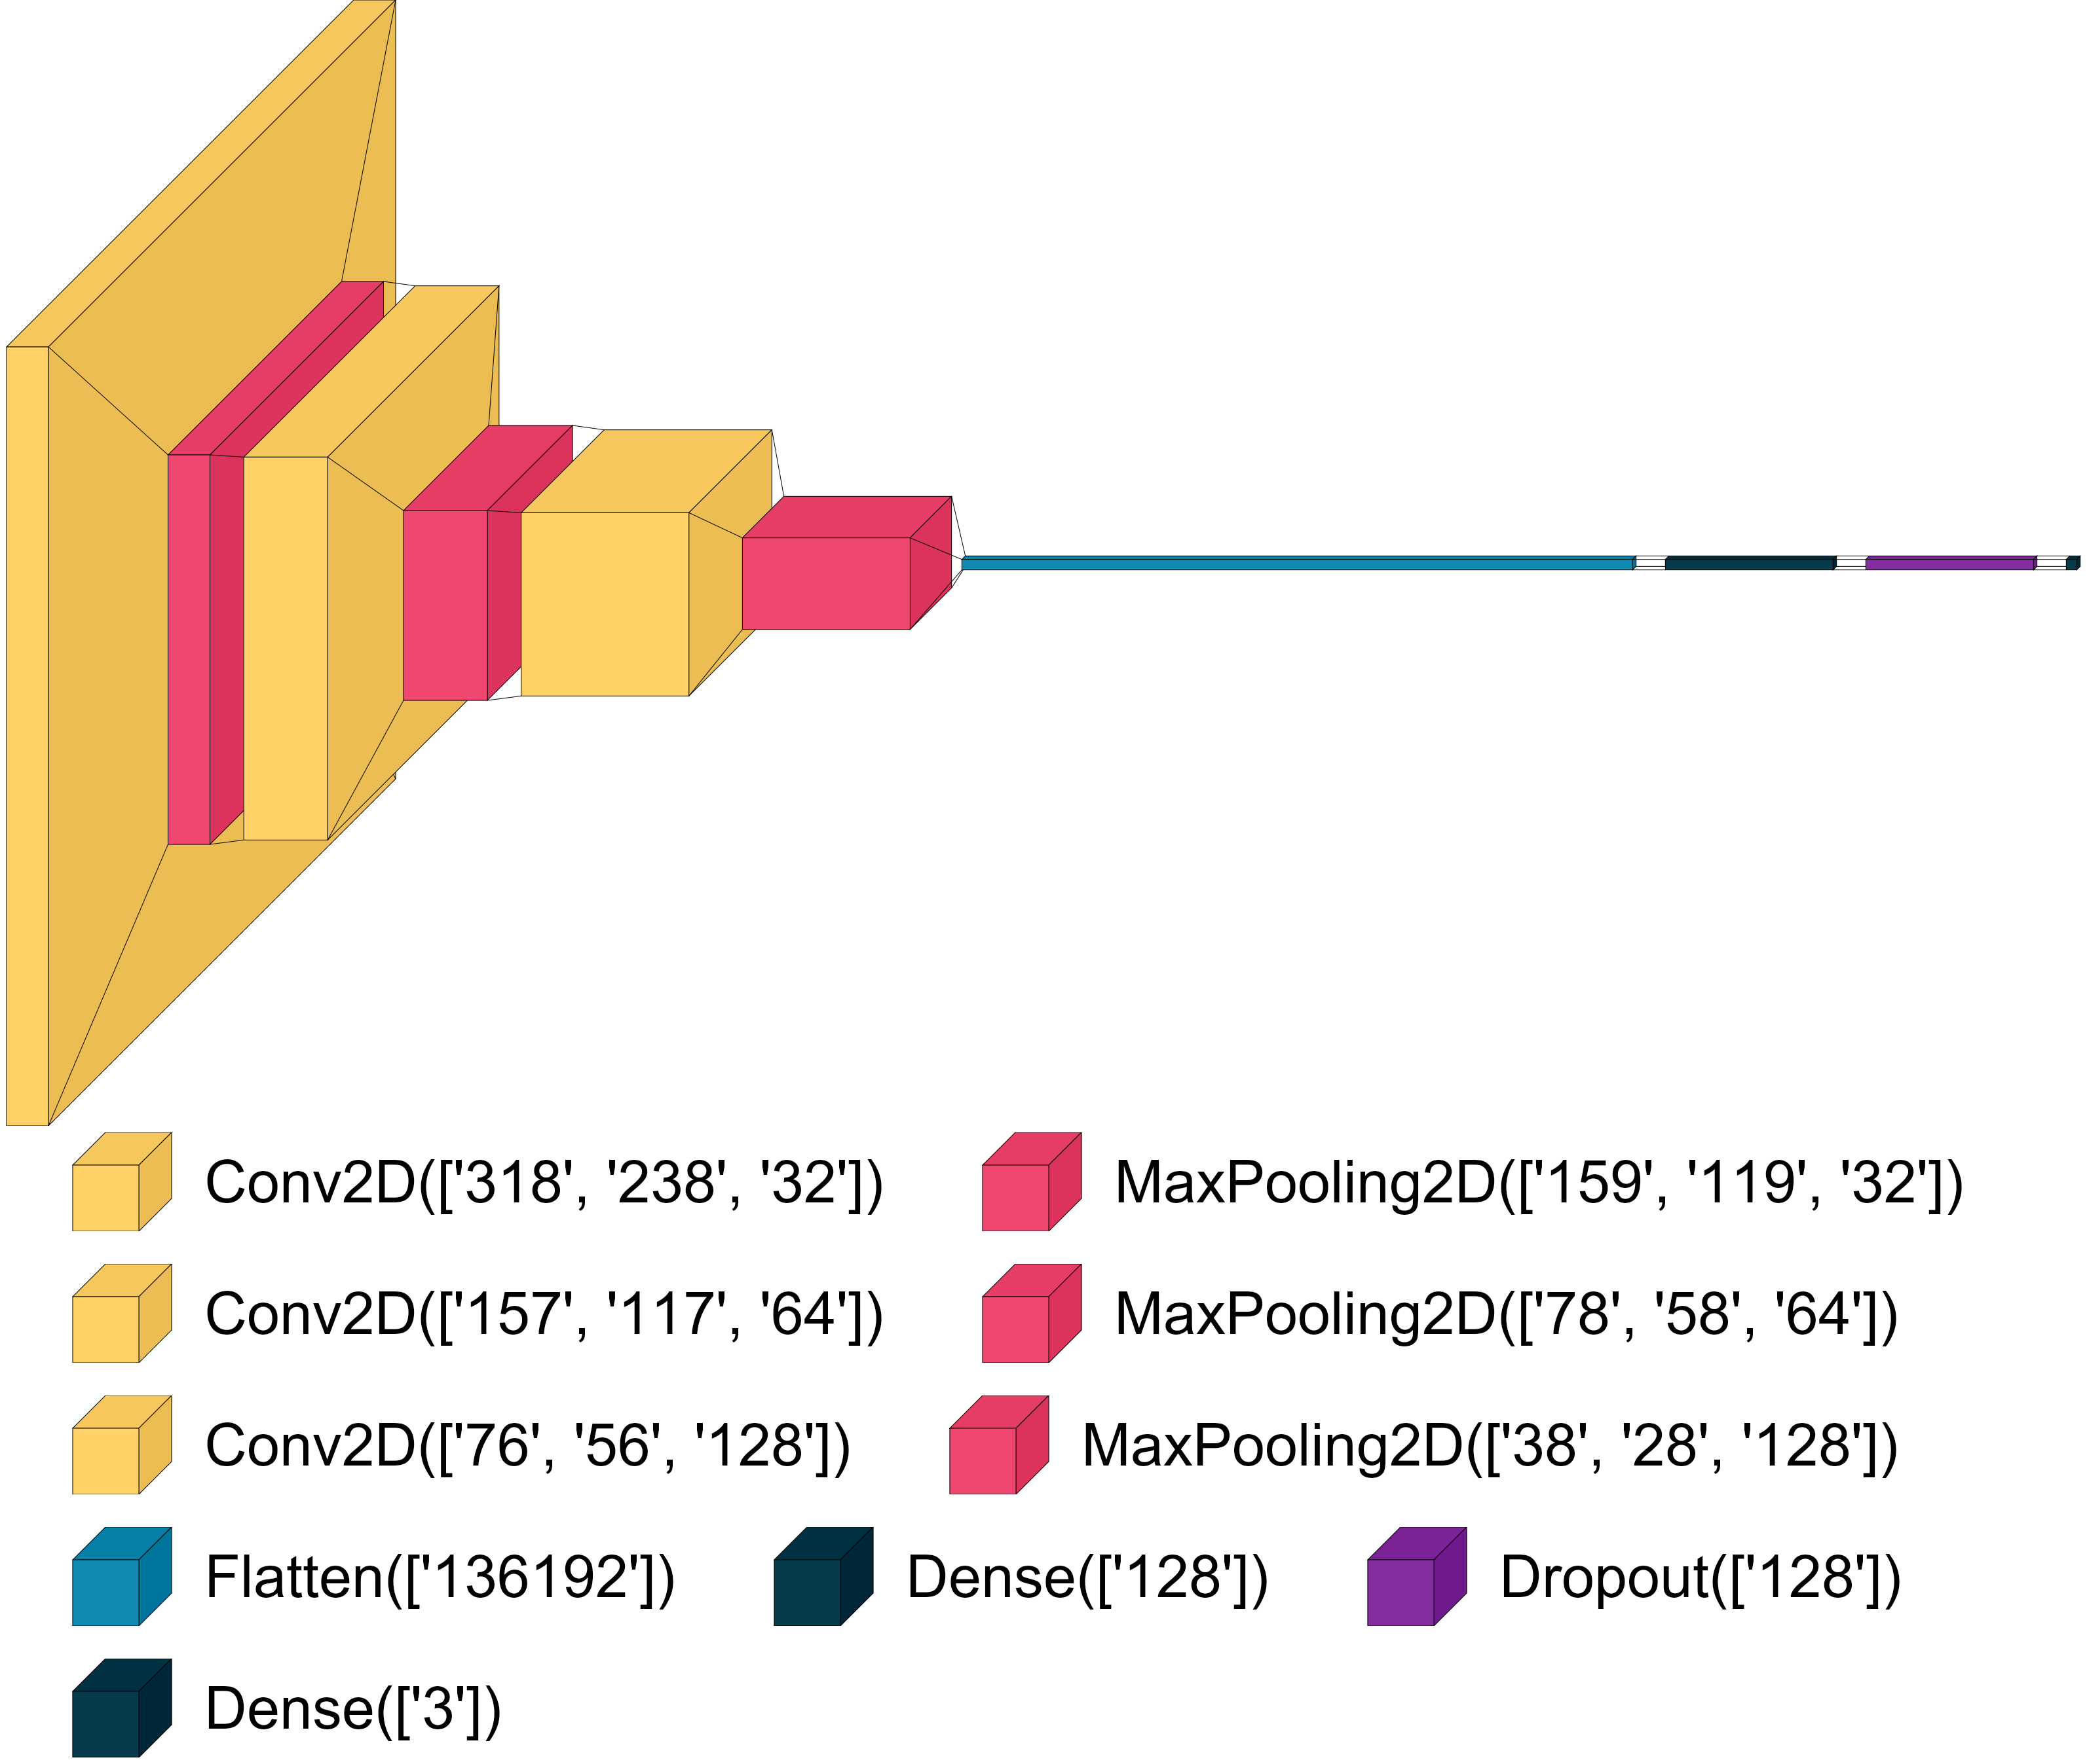
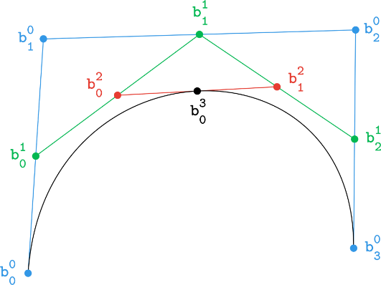
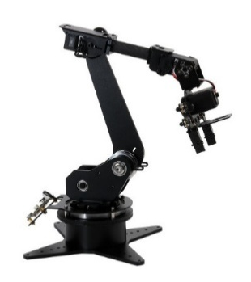
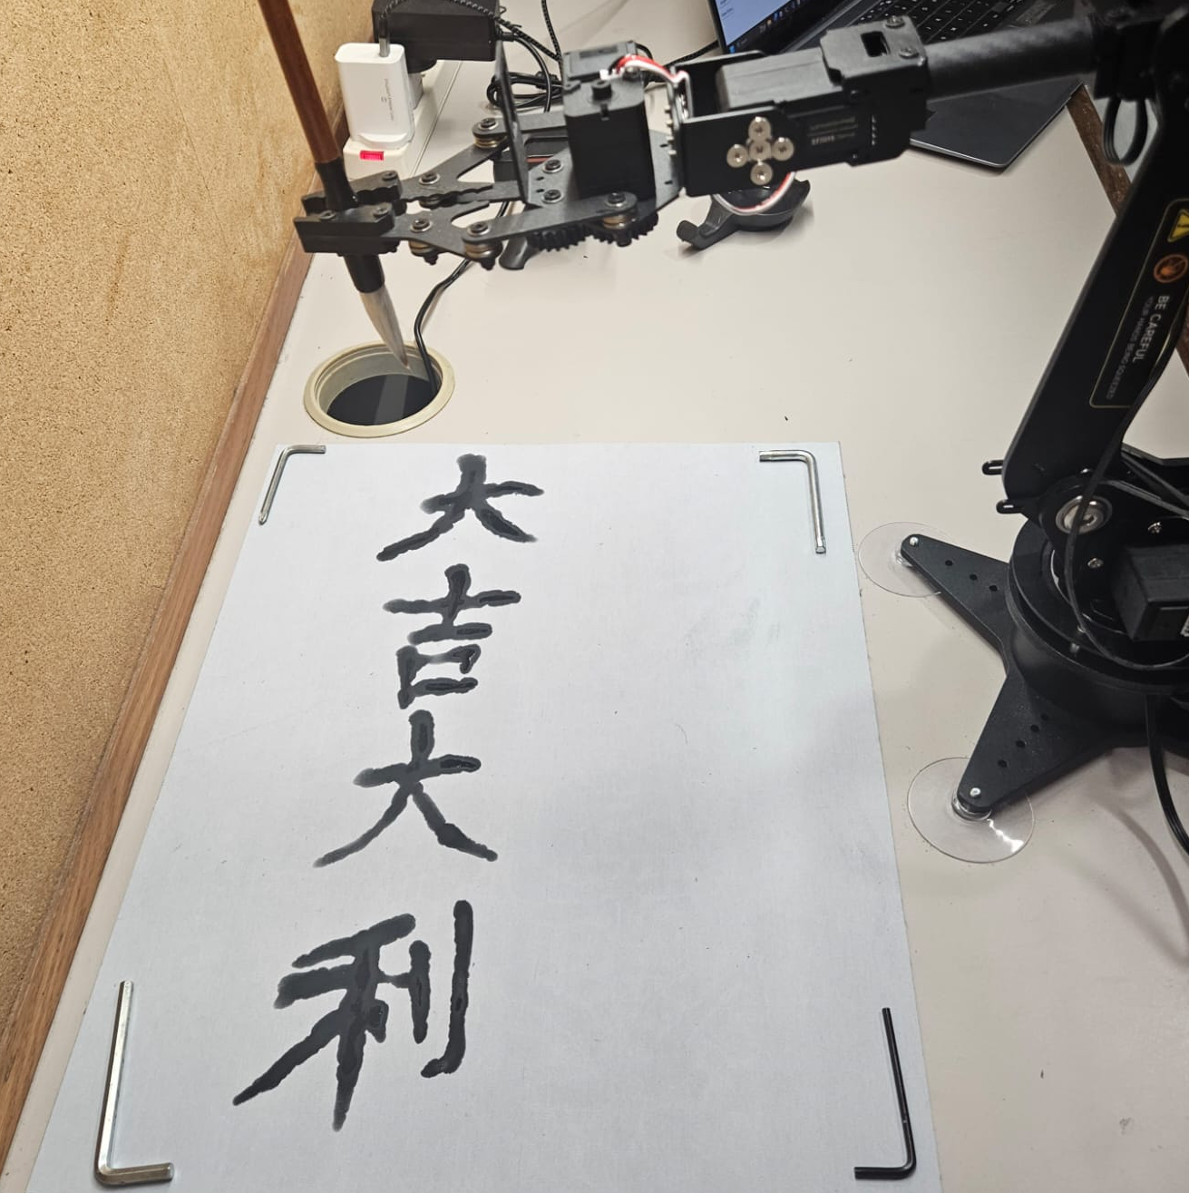
Main Objective
Combine:
Computer Vision
Bézier Curve
Robotic Arm
Chinese Calligraphy Robot
As no one has combined all 3 elements before
Notes:
So, the main objective of my FYP is to combine Computer Vision Machine Learning Model, Bezier Curve Path Plannnig, and Robotic Arm into a real life application of a Chinese Calligraphy Robot. As no one has combined all 3 elements together before.

Slide 5
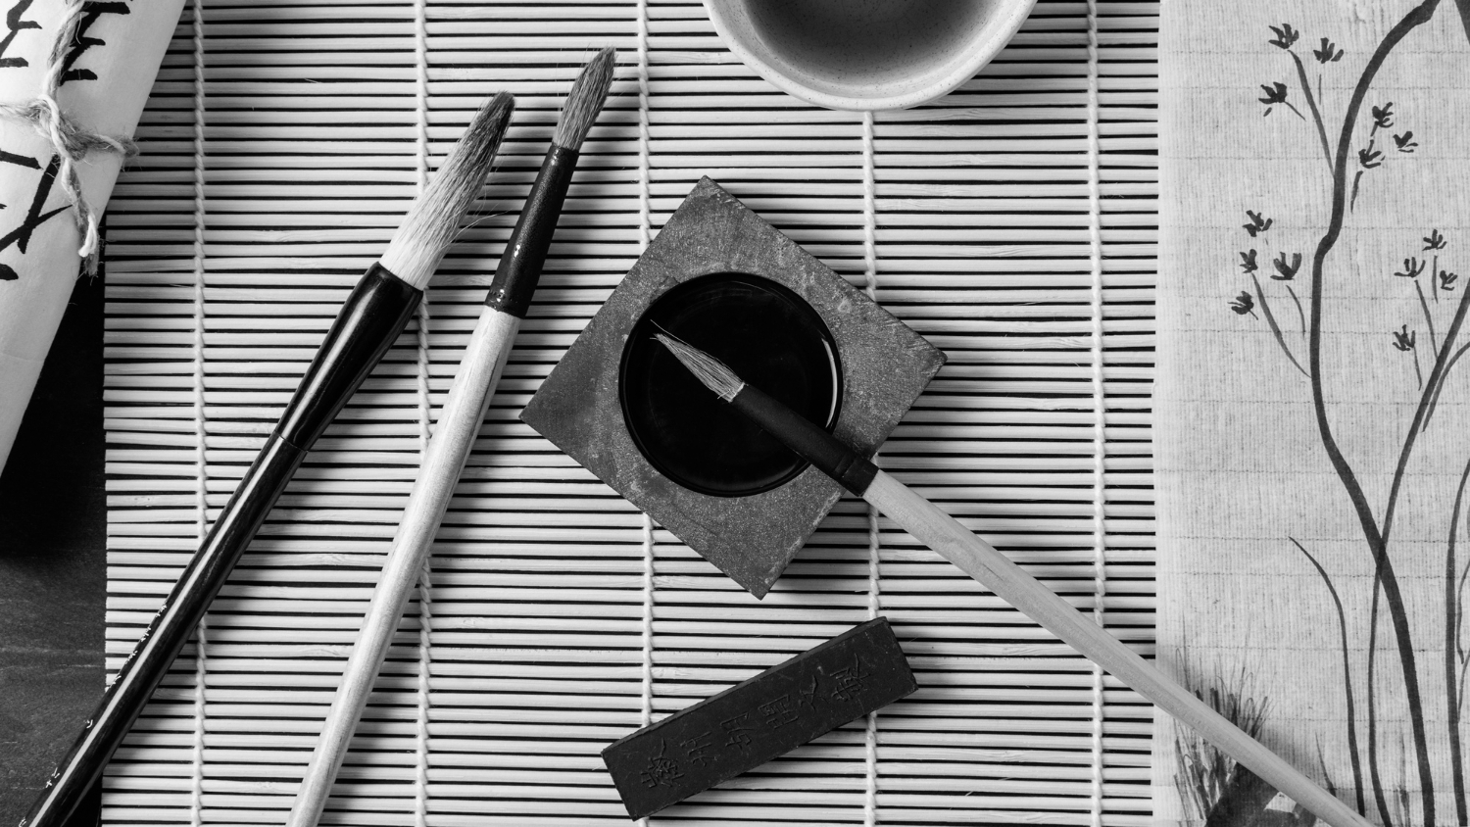
WHY CHINESE CALLIGRAPHY?
Notes:
You might ask, Why Chinese Calligraphy?

Slide 6
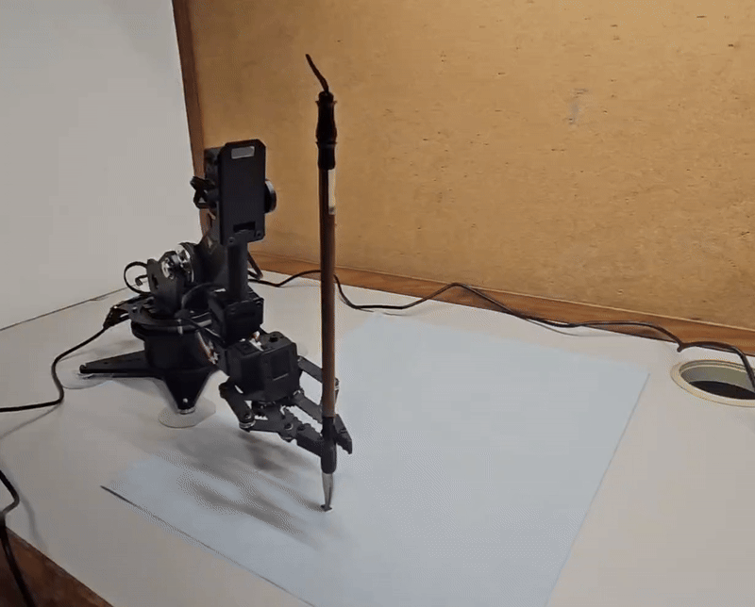
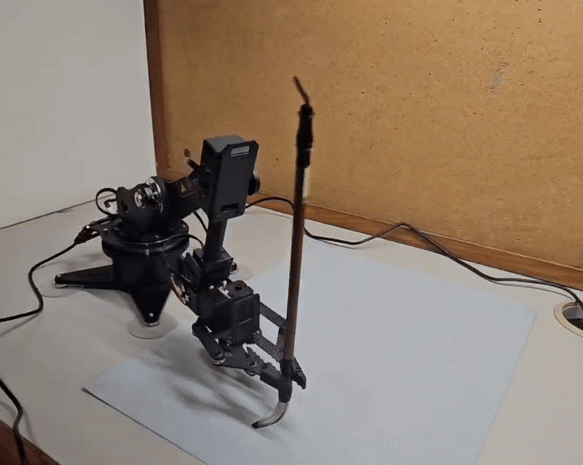
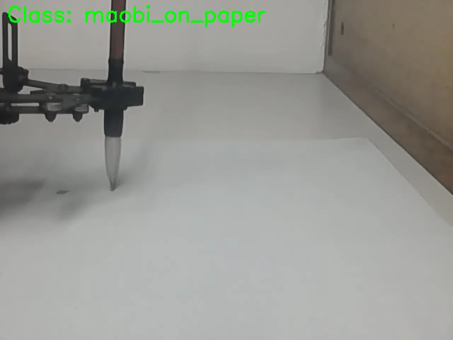
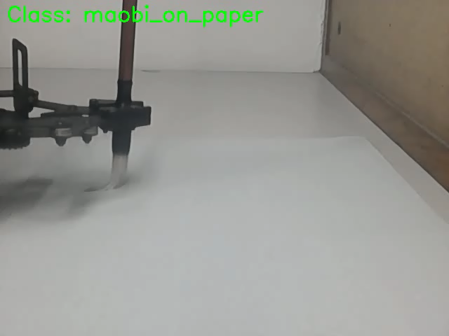
Because Chinese Calligraphy Visualizes 3D Trajectory
Why 3D? Thickness of brush strokes = Height
Lift up = Thin strokes
Press Down = Thick strokes
Notes:
I chose Chinese calligraphy as my application because Chinese calligraphy can visualize 3D Trajectory clearly. You might ask, Why is it 3D when the paper is 2D? It is because if we draw a line with the Chinese Calligraphy brush high in the air, the stroke drawn would be thin. If we press the brush onto the paper, the stroke would be thick. So, the thickness of the resulting brush strokes it draws can show the height of the trajectory, hence visualizing all 3 dimensions of the path planning algorithm.

Slide 7
02
METHODOLOGY
How I did this project?
Notes:
Now, let’s talk about how my project works.

Slide 8
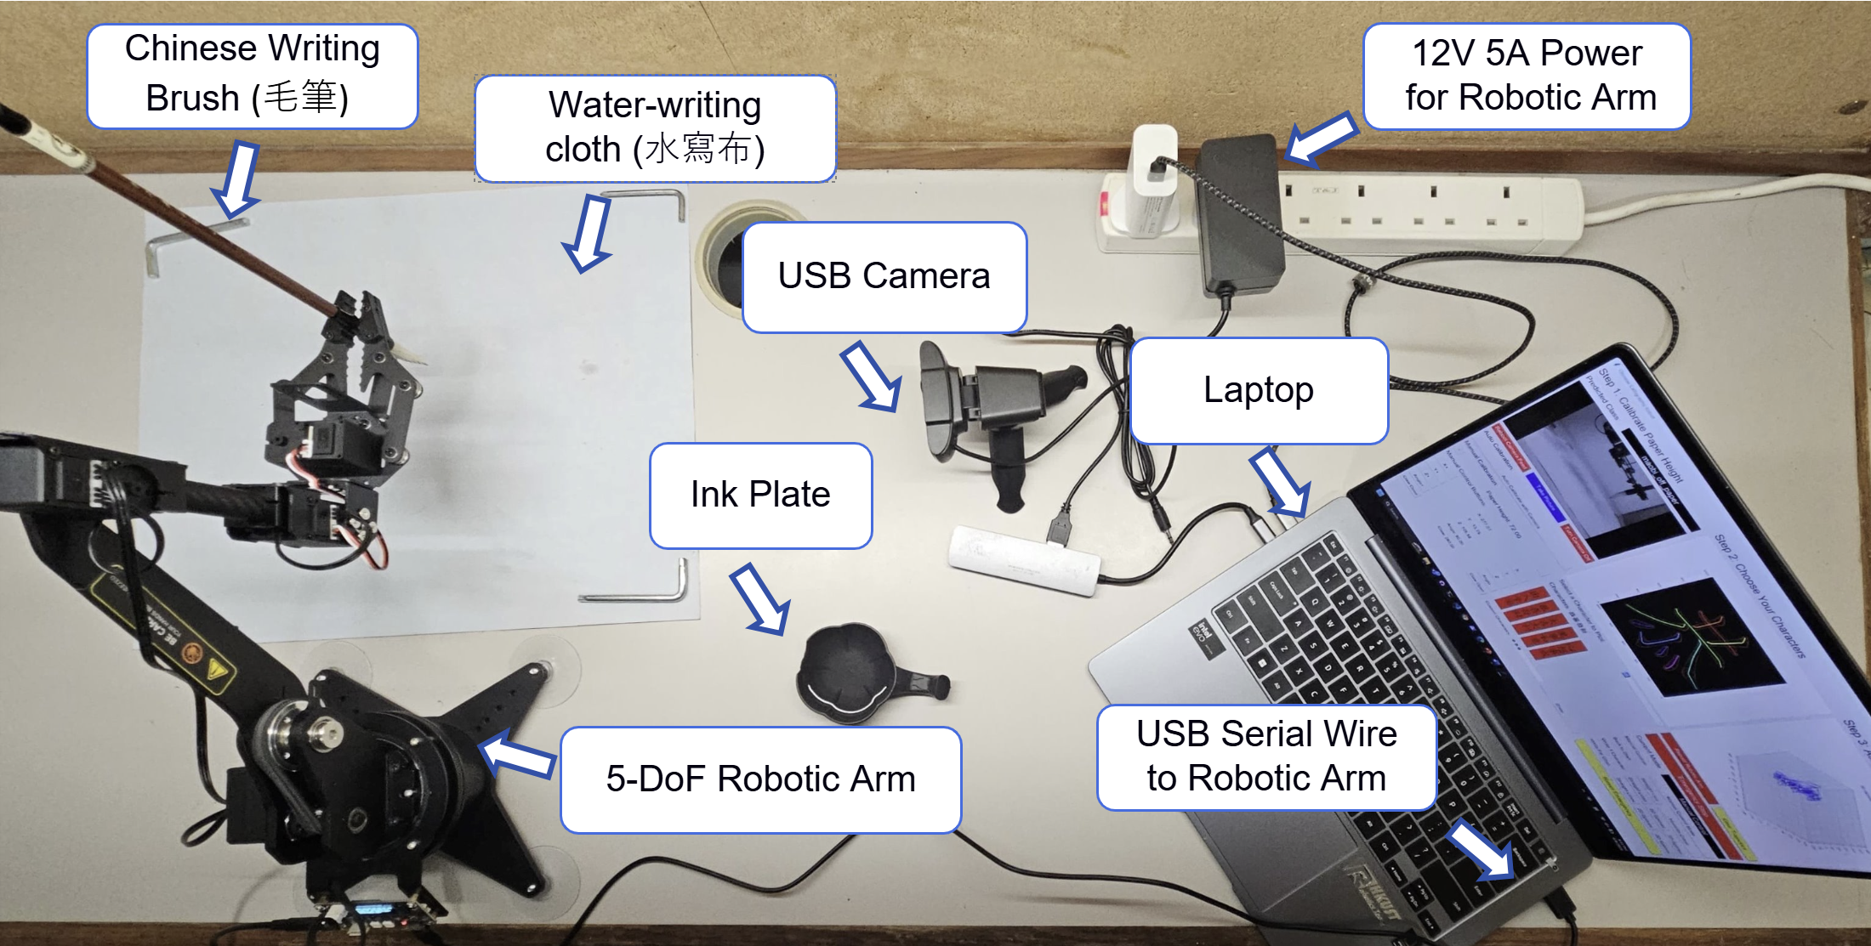
Experiment Setup
Notes:
So, this is the setup of my FYP. There is the robotic arm on the left that writes Chinese calligraphy on the white paper, the camera in the center for the computer vision system, and my laptop on the right with a UI that controls the whole system.

Slide 9
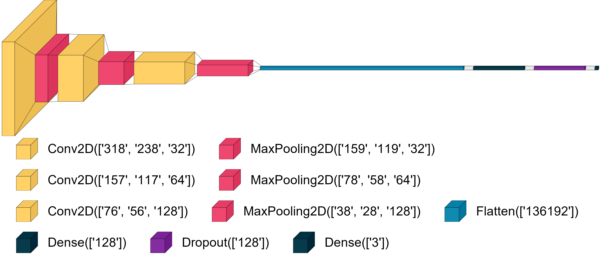

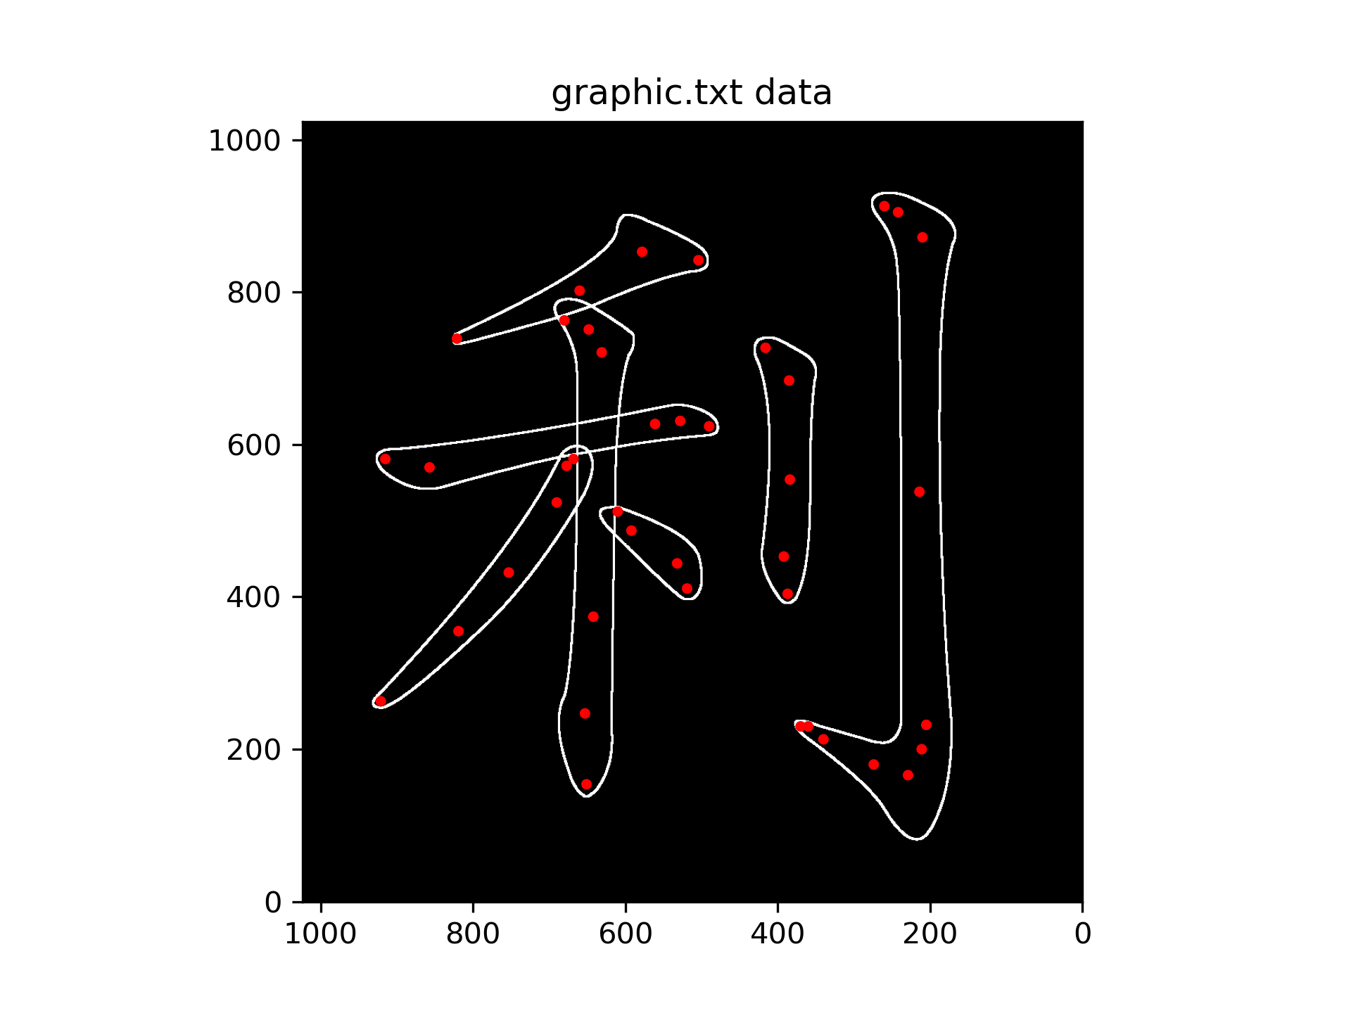
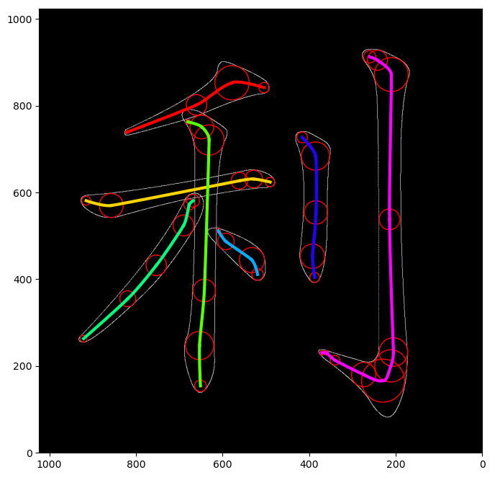
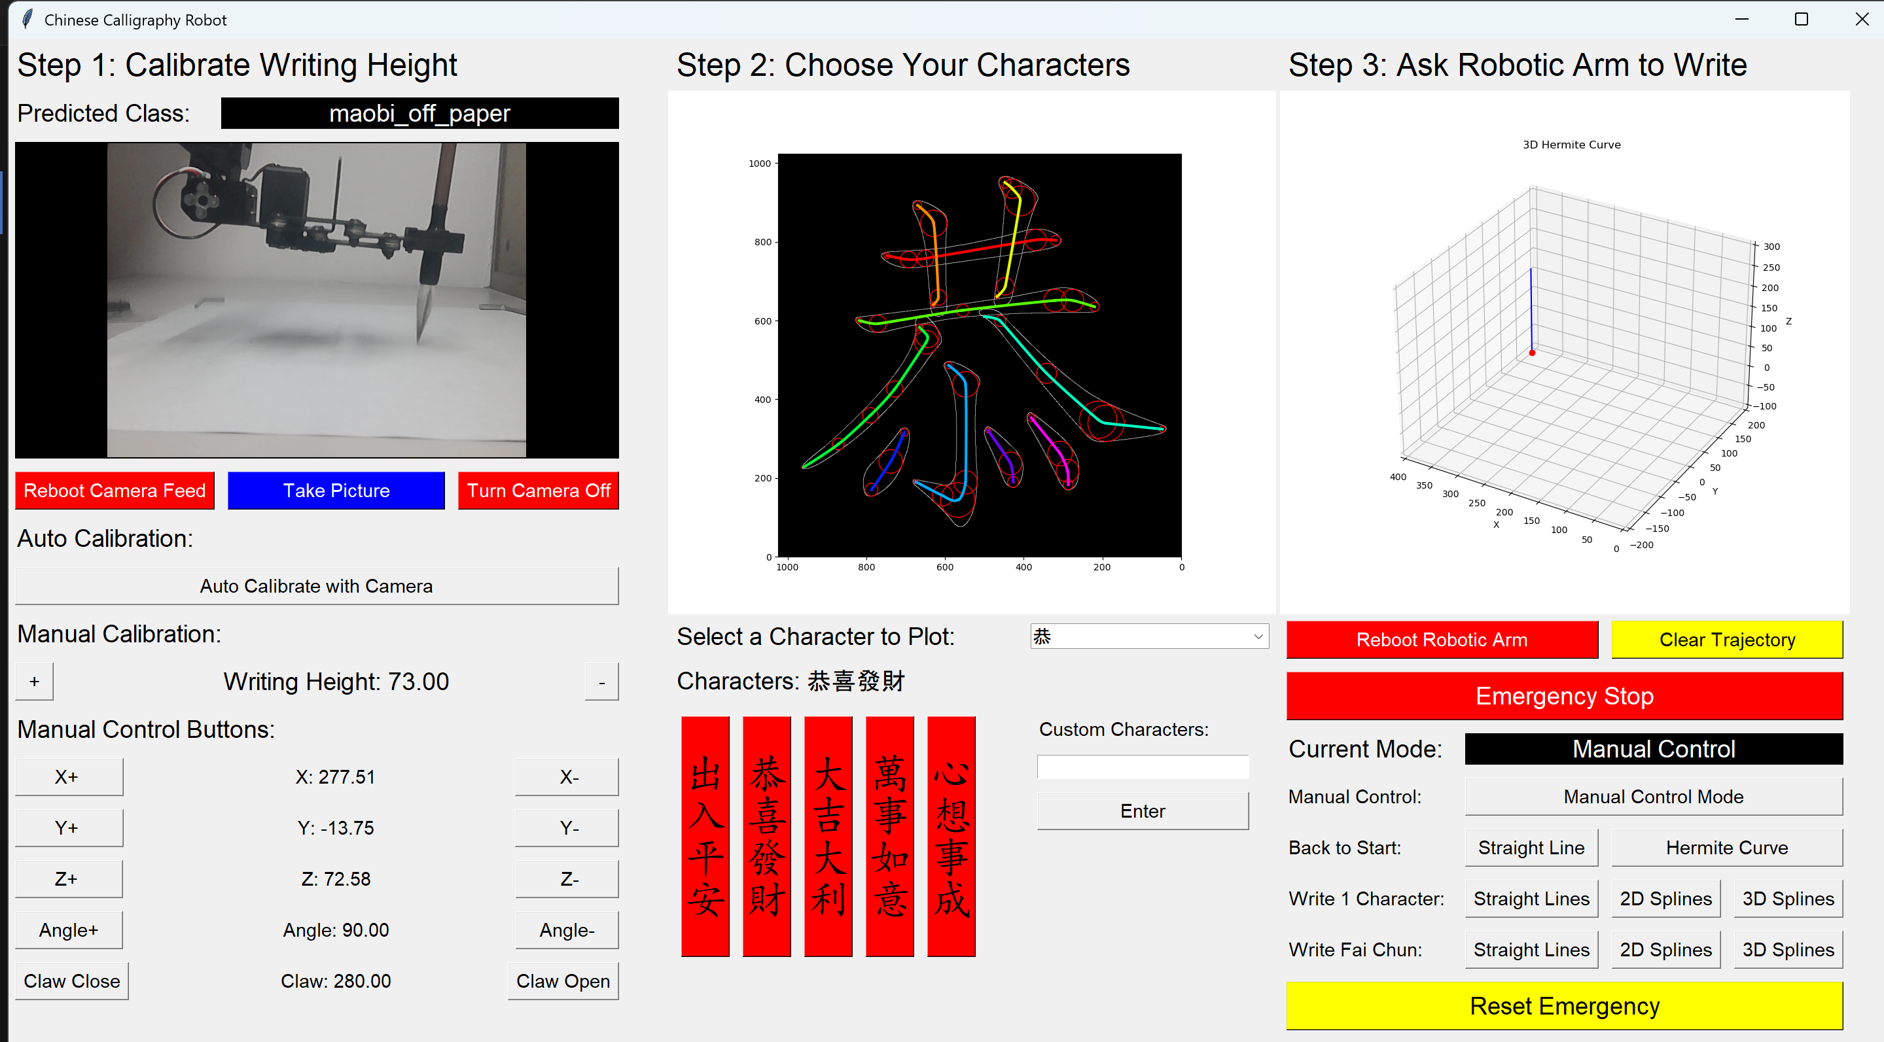
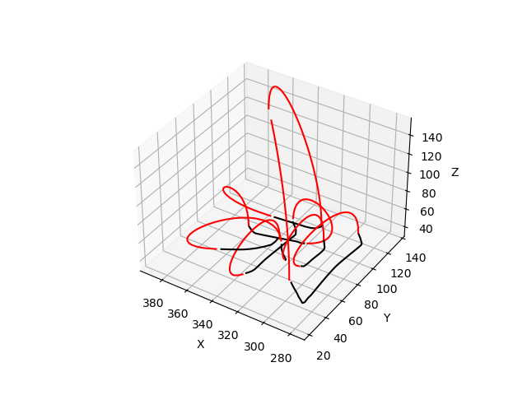
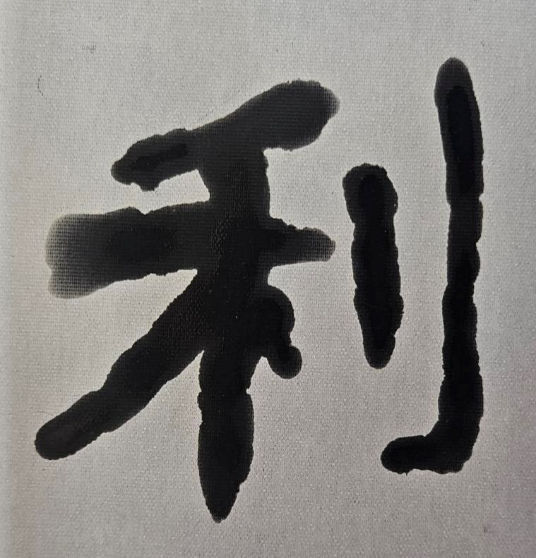
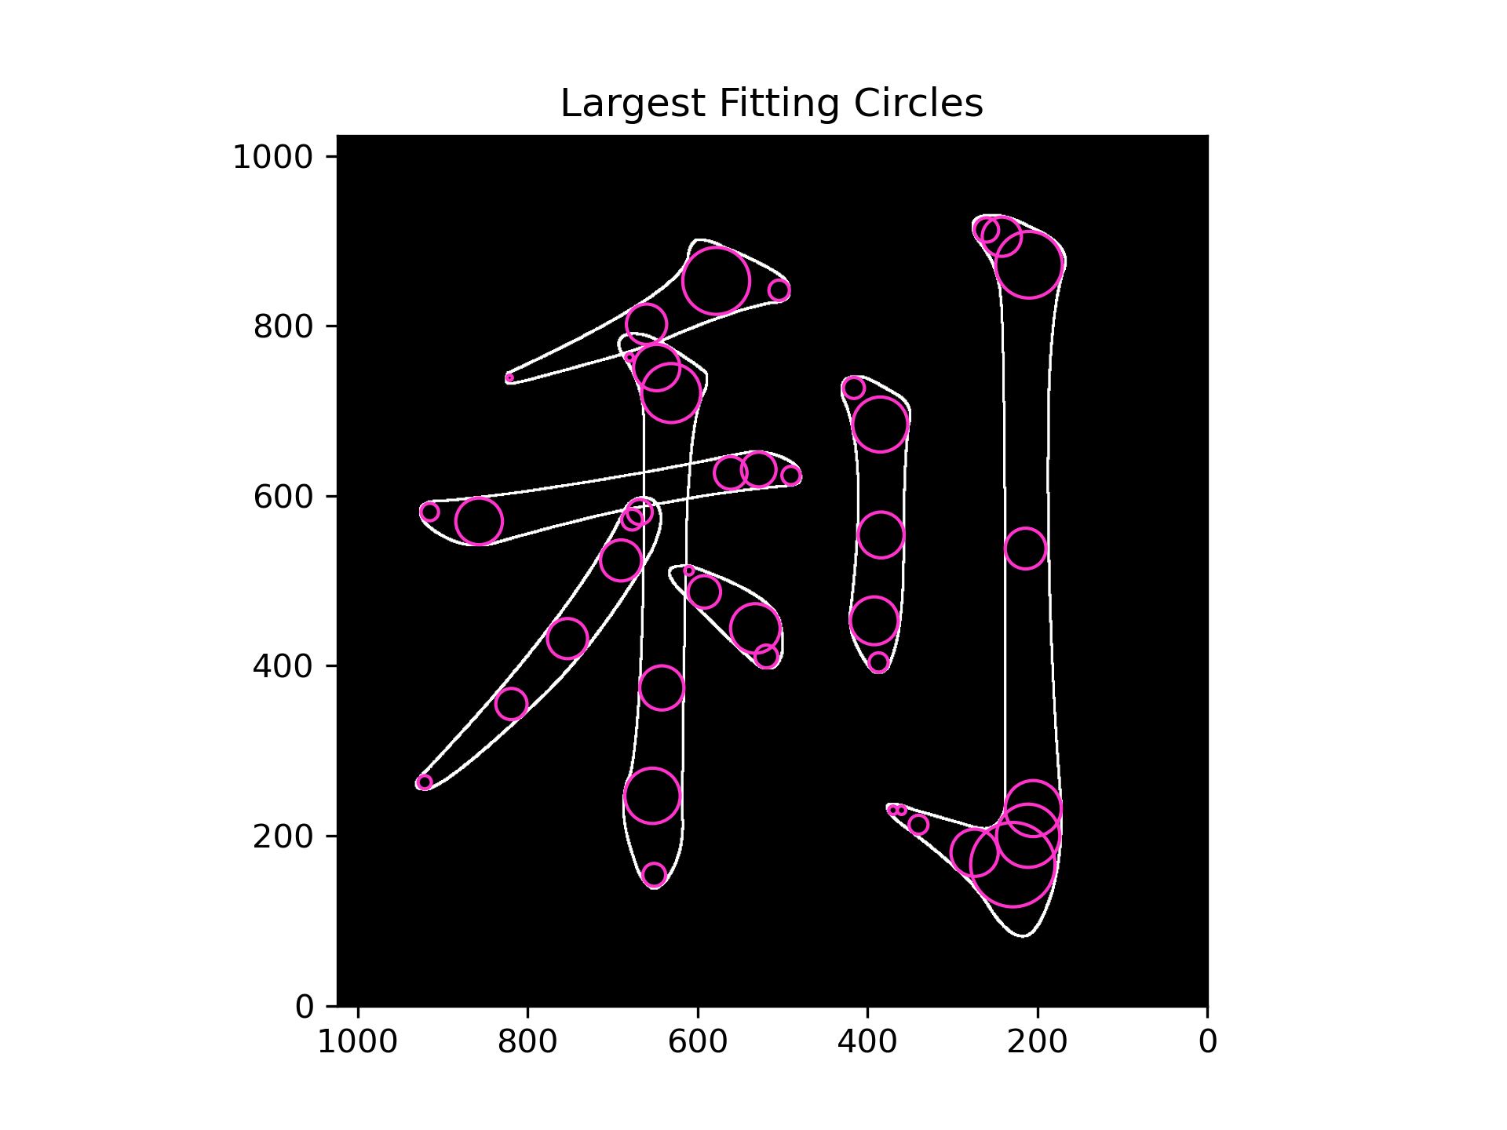
Workflow
Computer Vision System
Control Point Generation
Trajectory Generation
Robot Manipulation
CNN Model
Fetch 2D Control Points
3D Bézier Splines
Control Robotic Arm
Calibrate Writing Height
Generate 3D
Control Points
Add Connecting
Hermite Curves
Chinese Calligraphy
Notes:
This is the workflow of my system and I will talk about it in detail.

Slide 10
Computer Vision System
Computer Vision System
Control Point Generation
Trajectory Generation
Robot Manipulation
CNN Model
Fetch 2D Control Points
3D Bézier Splines
Control Robotic Arm
Calibrate Writing Height
Generate 3D
Control Points
Add Connecting
Hermite Curves
Chinese Calligraphy
Notes:
The first part is the computer vision system.

Slide 11
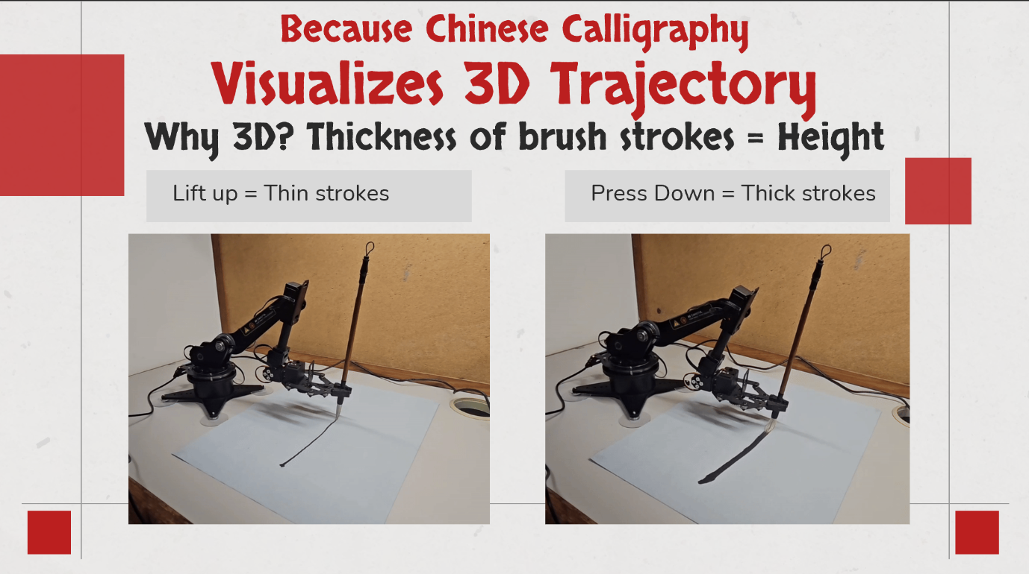
As Brush Height affects Stroke Thickness,
Notes:
As I mentioned before, the height of the brush is important as it affects the stroke thickness

Slide 12
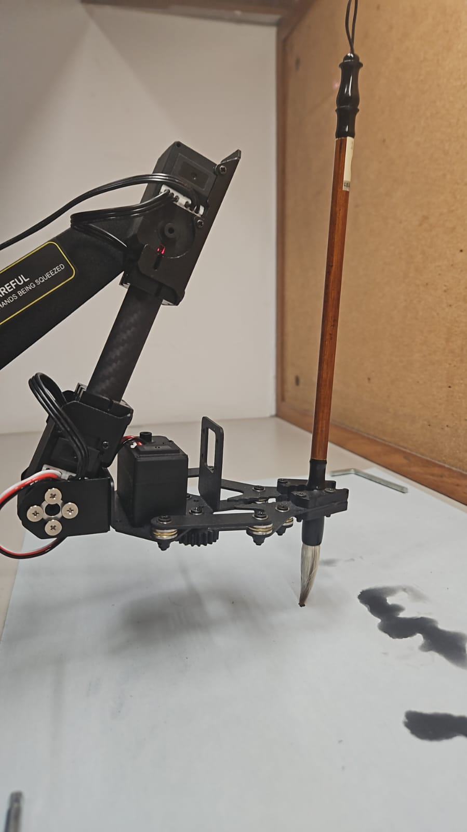
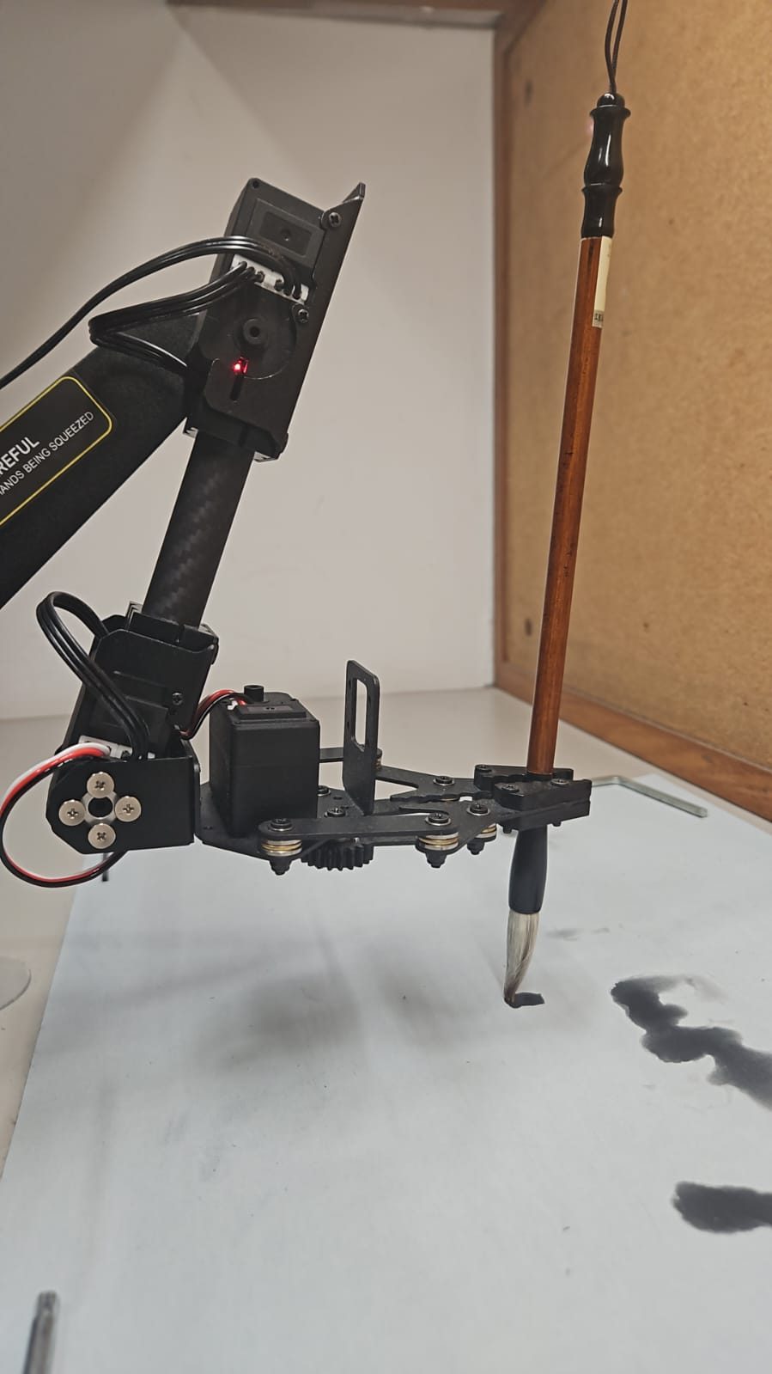
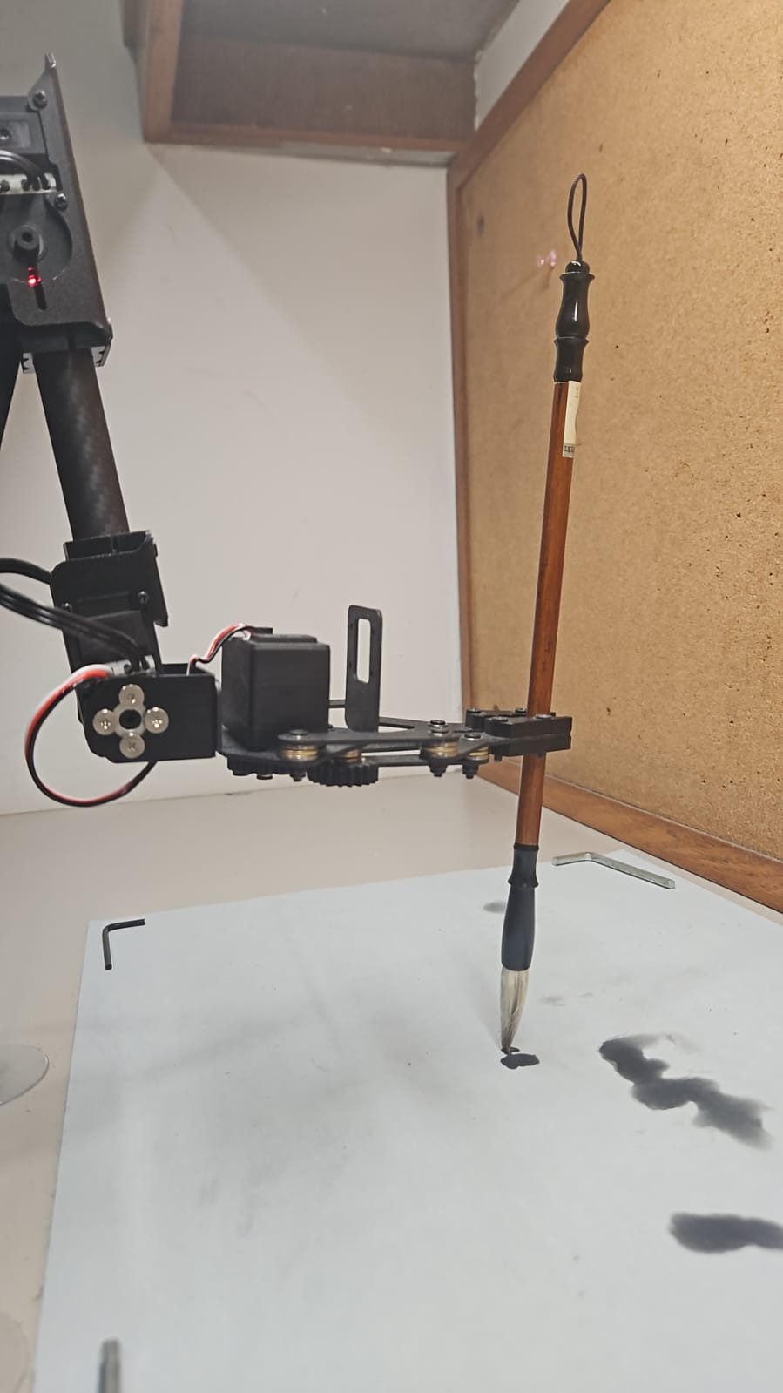
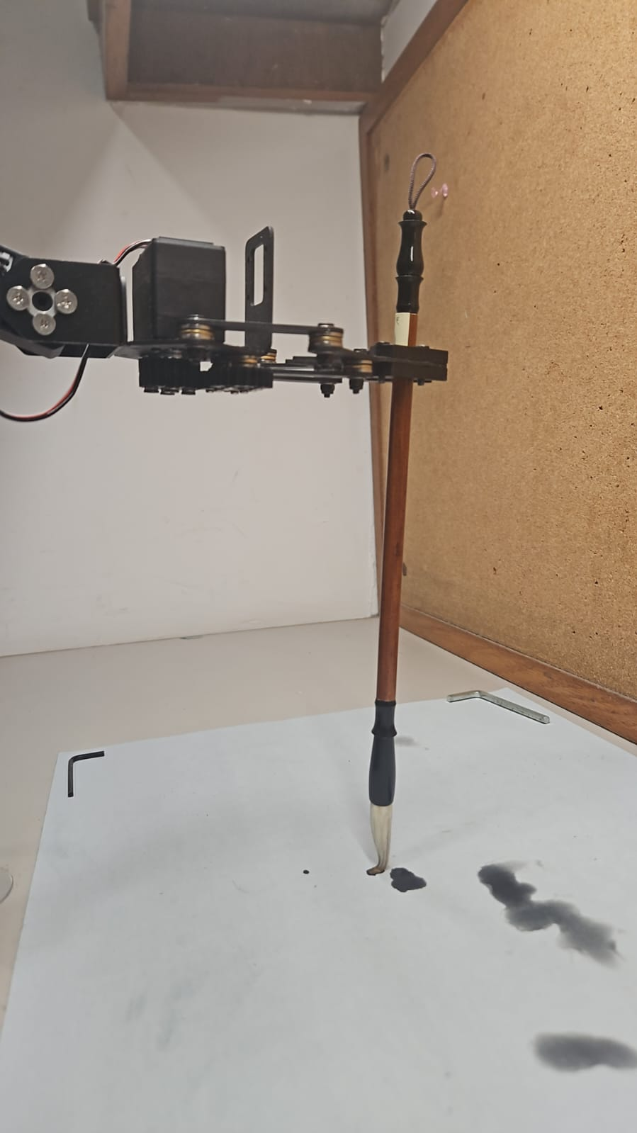
and the Brush is NOT fixed on the Gripper
So, we need to calibrate where the gripper is holding the brush.
i.e. calibrate the distance between the gripper and the paper
when the brush touches the paper.
Notes:
And I did not fix the brush onto the robotic arm like other similar projects. So, I need to calibrate where the gripper is holding the brush by detecting when/where the brush touches the paper.

Slide 13
So, I use a Camera to detect if the brush touches the paper or not
Notes:
So, I added this camera in the middle to see whether the brush touches the paper or not.

Slide 14
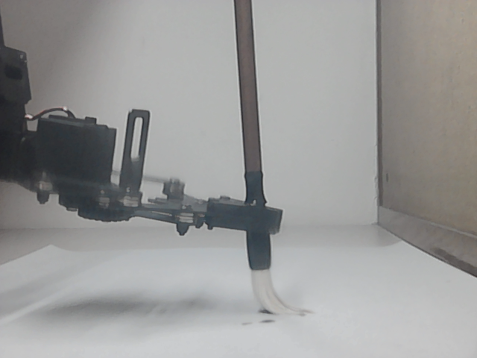
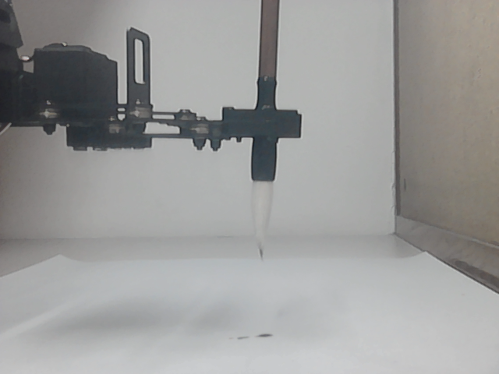
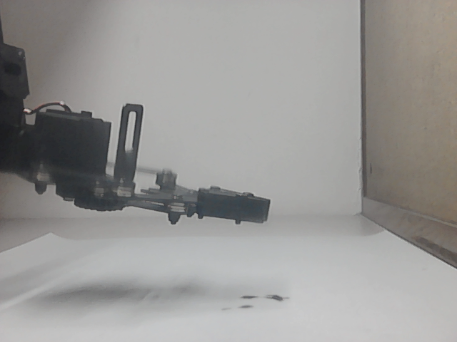
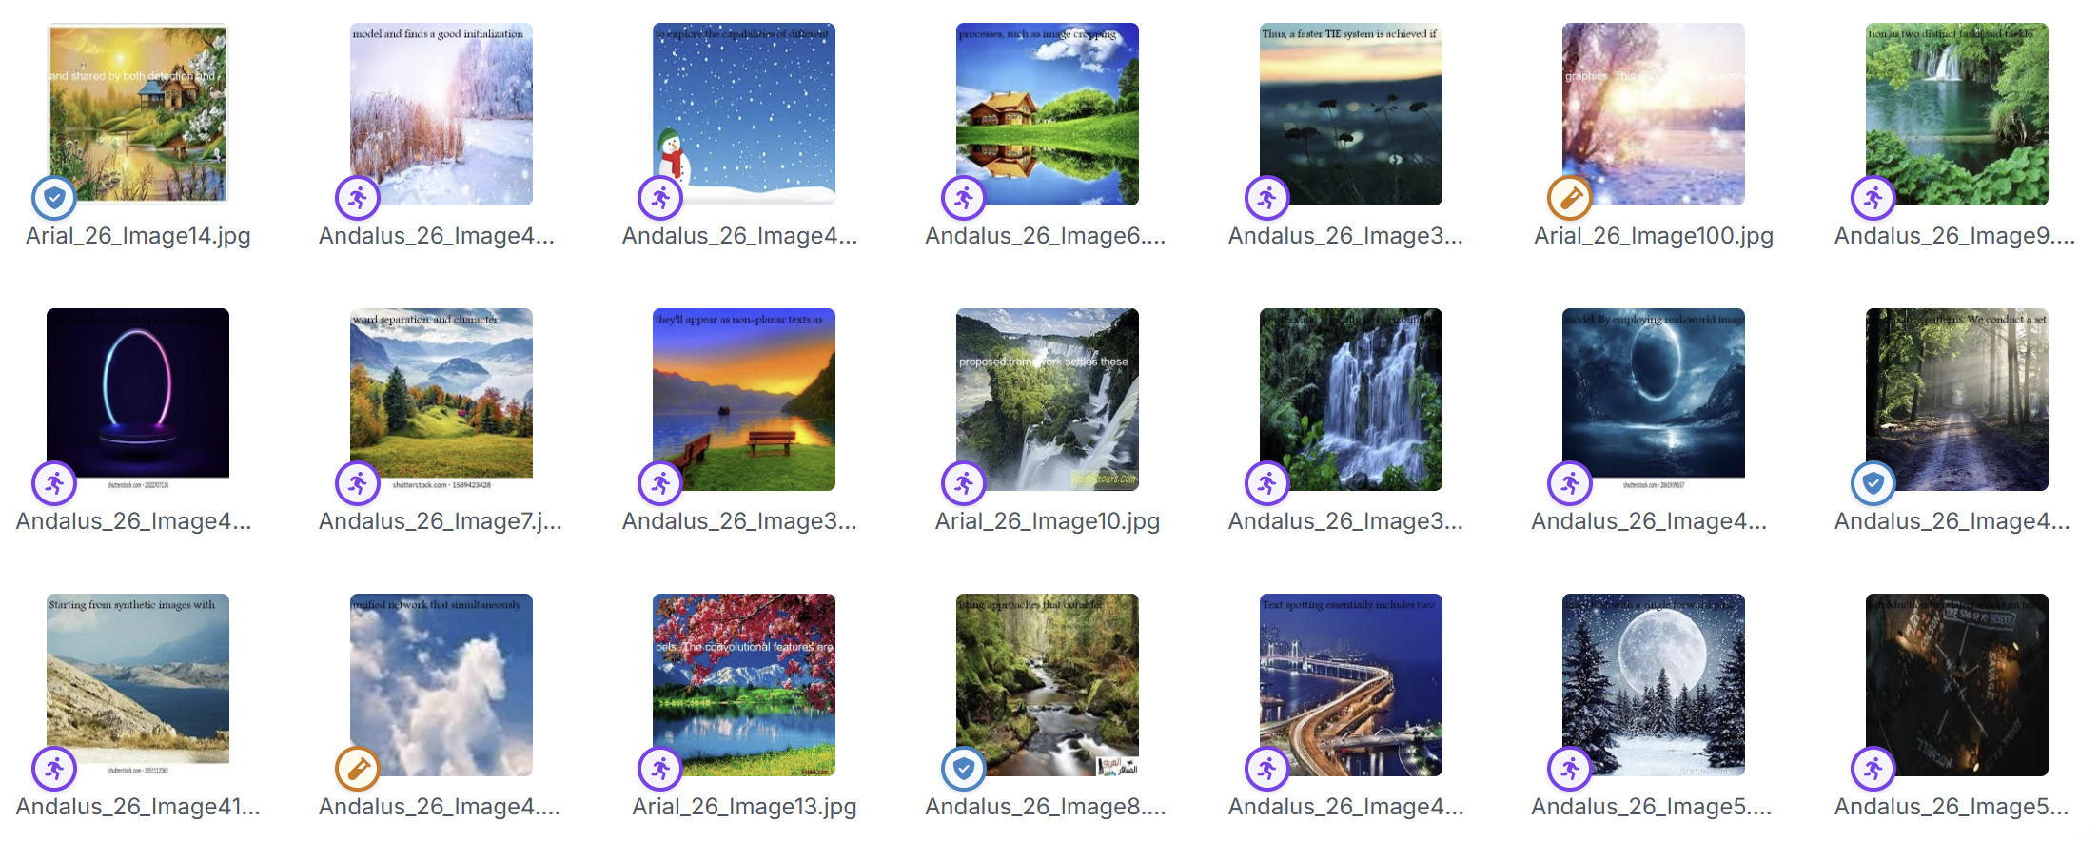
Computer Vision Dataset
Annotated 994 Images, Augmented to 2386 Images
maobi_on_paper | maobi_off_paper | no_maobi
The Brush is Bent | The Brush is Straight | There is No Brush
268 Images | 463 Images | 63 Images + 200 Random Images
Notes:
And these are the images taken with that camera. I splited it into 3 classes: maobi_on_paper where the brush is touching the paper and is bent; maobi_off_paper where the brush is Not touching the paper and is straight; and no_maobi where the brush is outside the view of the camera. I annotated 994 images and augmented these 994 images into 2386 Images for my dataset.

Slide 15
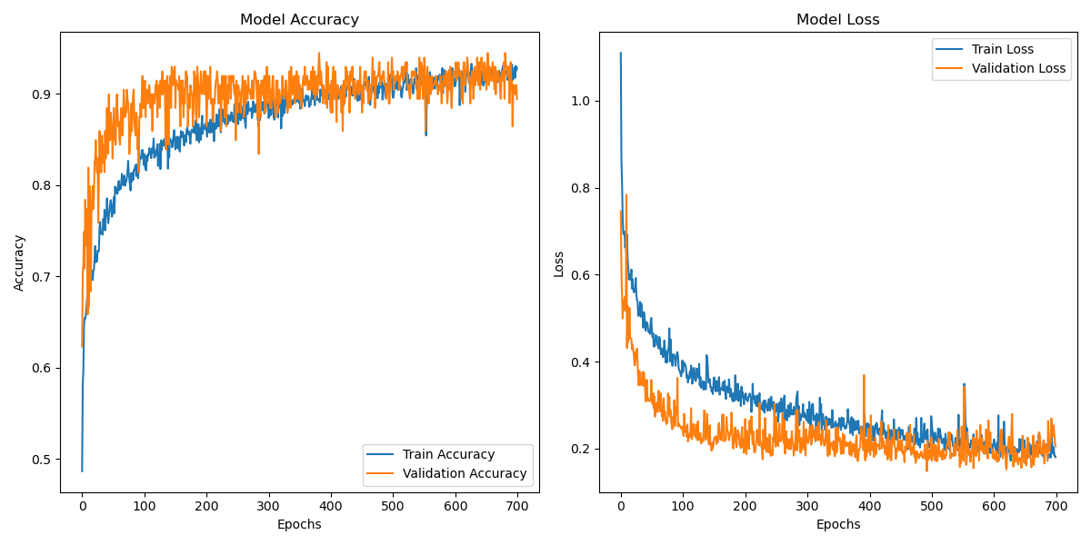
CNN Object Classification Model
700 Epoches, Best Validation Accuracy: 94.472%
Notes:
I trained my CNN Object Classification model on this dataset for 700 epochs and the best validation accuracy is 94.4%.

Slide 16
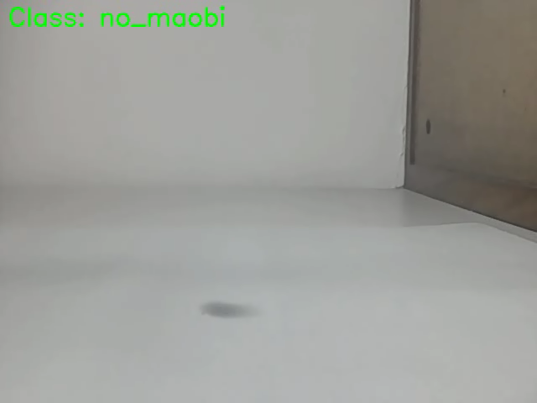
Gripper Writing Height Calibration
Notes:
This is the result of the model. I lower the brush until it shows maobi_on_paper. Then, lift it up until it is maobi_off_paper. The height of the robotic arm’s gripper would be my calibrated value.

Slide 17
Control Point Generation
Computer Vision System
Control Point Generation
Trajectory Generation
Robot Manipulation
CNN Model
Fetch 2D Control Points
3D Bézier Splines
Control Robotic Arm
Calibrate Writing Height
Generate 3D
Control Points
Add Connecting
Hermite Curves
Chinese Calligraphy
Notes:
So, the next part is the control point generation.

Slide 18
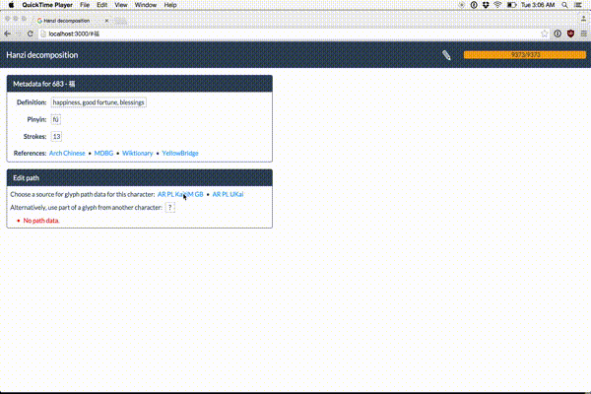
Fetch 2D Control Points
From Make Me a Hanzi Dataset
Notes:
I fetch the 2D control points of the chosen Chinese characters from an open-source dataset called Make Me a Hanzi. It includes the red control points and the white boundary in stroke order.

Slide 19
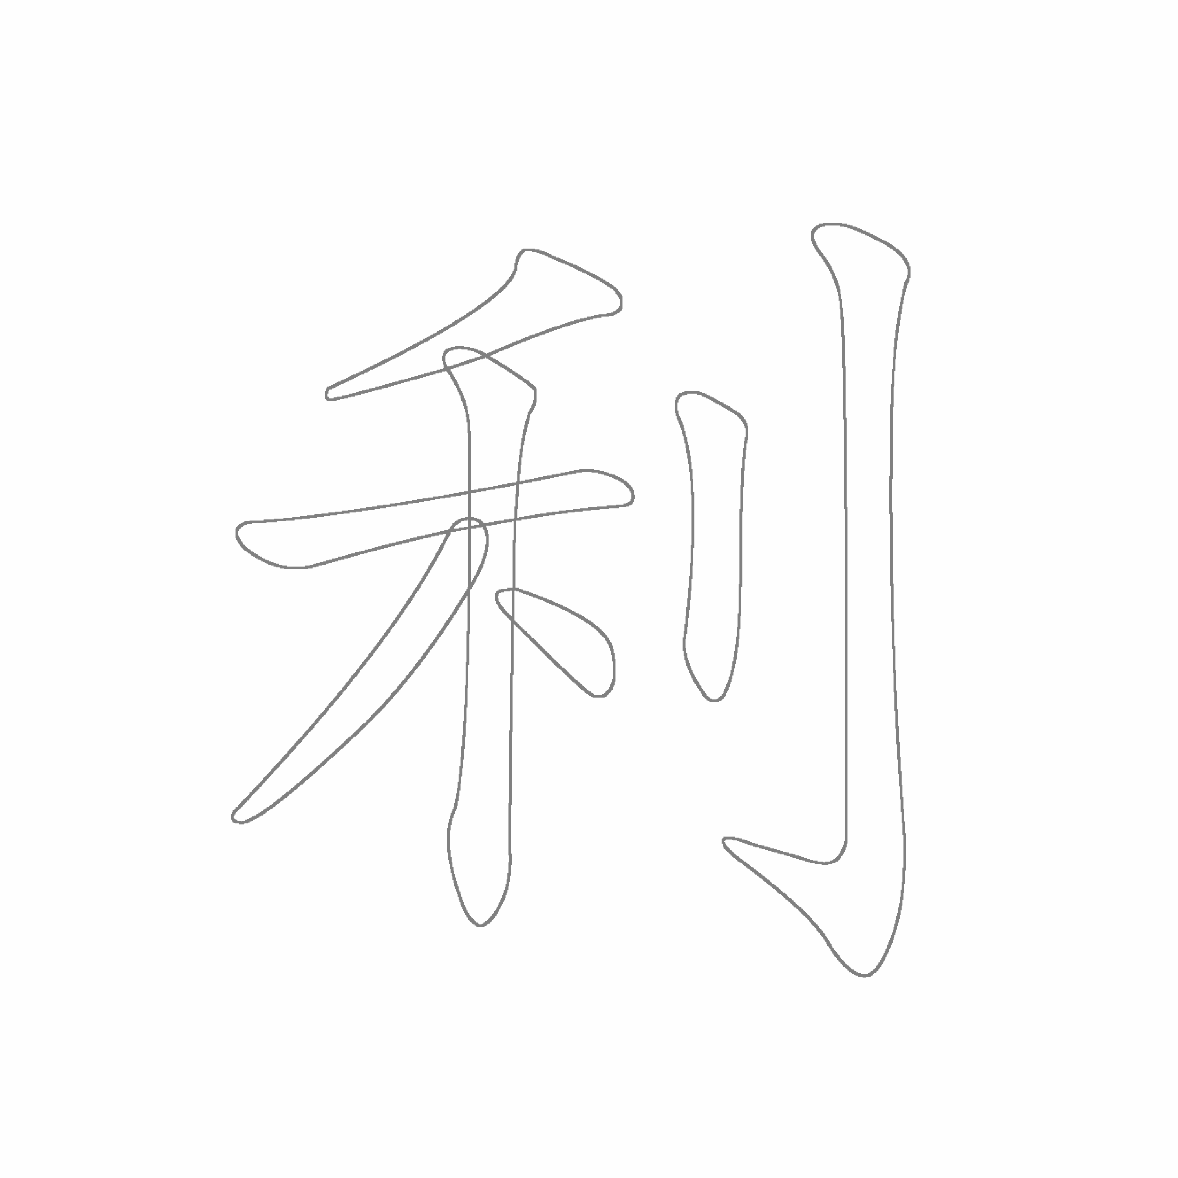
Calculate 3D control points
using Largest Fitting Circles
Notes:
So, I developed a largest fitting circles algorithm to convert the 2D control points to 3D. From each red control points, I increases the radius of the circle until it touches the boundary of the stroke. The size of these circles represent the stroke thickness, thus we can calculate their corresponding height of the Chinese calligraphy brush, which is the Z coordinates. So, we have 3D control points.

Slide 20
Trajectory Generation
Computer Vision System
Control Point Generation
Trajectory Generation
Robot Manipulation
CNN Model
Fetch 2D Control Points
3D Bézier Splines
Control Robotic Arm
Calibrate Writing Height
Generate 3D
Control Points
Add Connecting
Hermite Curves
Chinese Calligraphy
Notes:
After we have the control points, we connect them into trajectories.

Slide 21
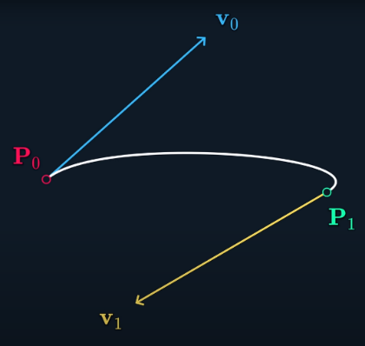
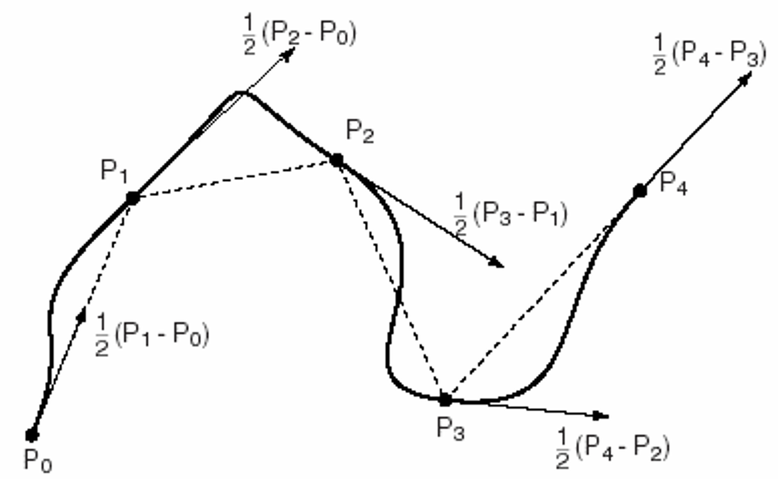
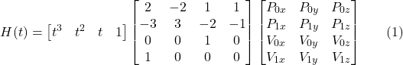
CONCEPTS
Hermite Curve
Catmull-Rom Spline
I connect 2 control points together with Hermite curve.
But we are missing v0 and v1
So, I uses Catmull-Rom Spline to calculate v0 and v1 to connect multiple Hermite curves
Notes:
I uses Hermite curve, which is a variant of Bezier curve, to connect 2 control points together. As there are more than 2 control points in a stroke, I tried to use Catmull-Rom Spline to calculate the control velocities v0 and v1 of the Hermite curve to connect multiple Hermite curves together.

Slide 22
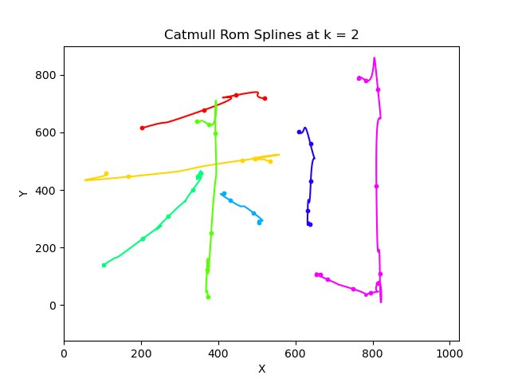
But Catmull-Rom Spline is not good
Notes:
However, Catmull-Rom Spline creates these strange backward movement as the control points are not uniformly spaced.

Slide 23
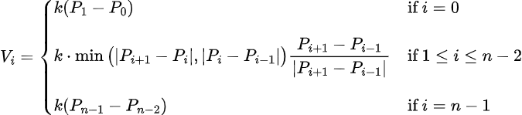
Modified Catmull-Rom Spline
Notes:
So, I modified the Catmull-Rom spline by limiting the magnitude of the control velocities to the distance to the closest control points. This prevents those backward movement and this is the result.

Slide 24
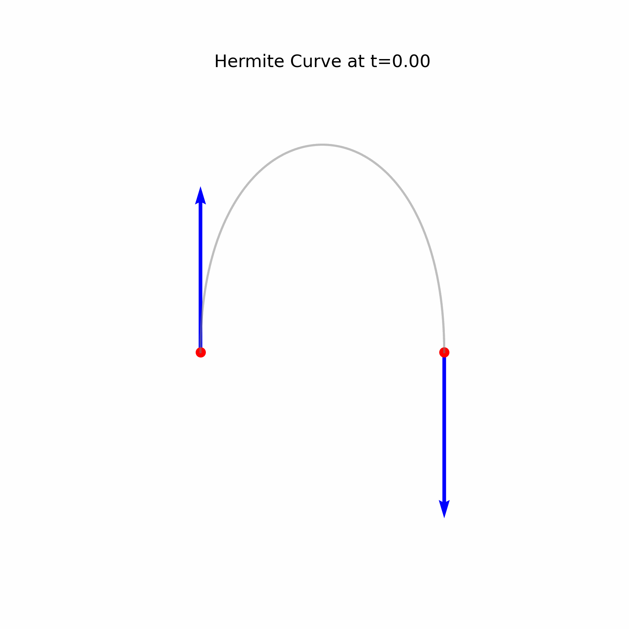
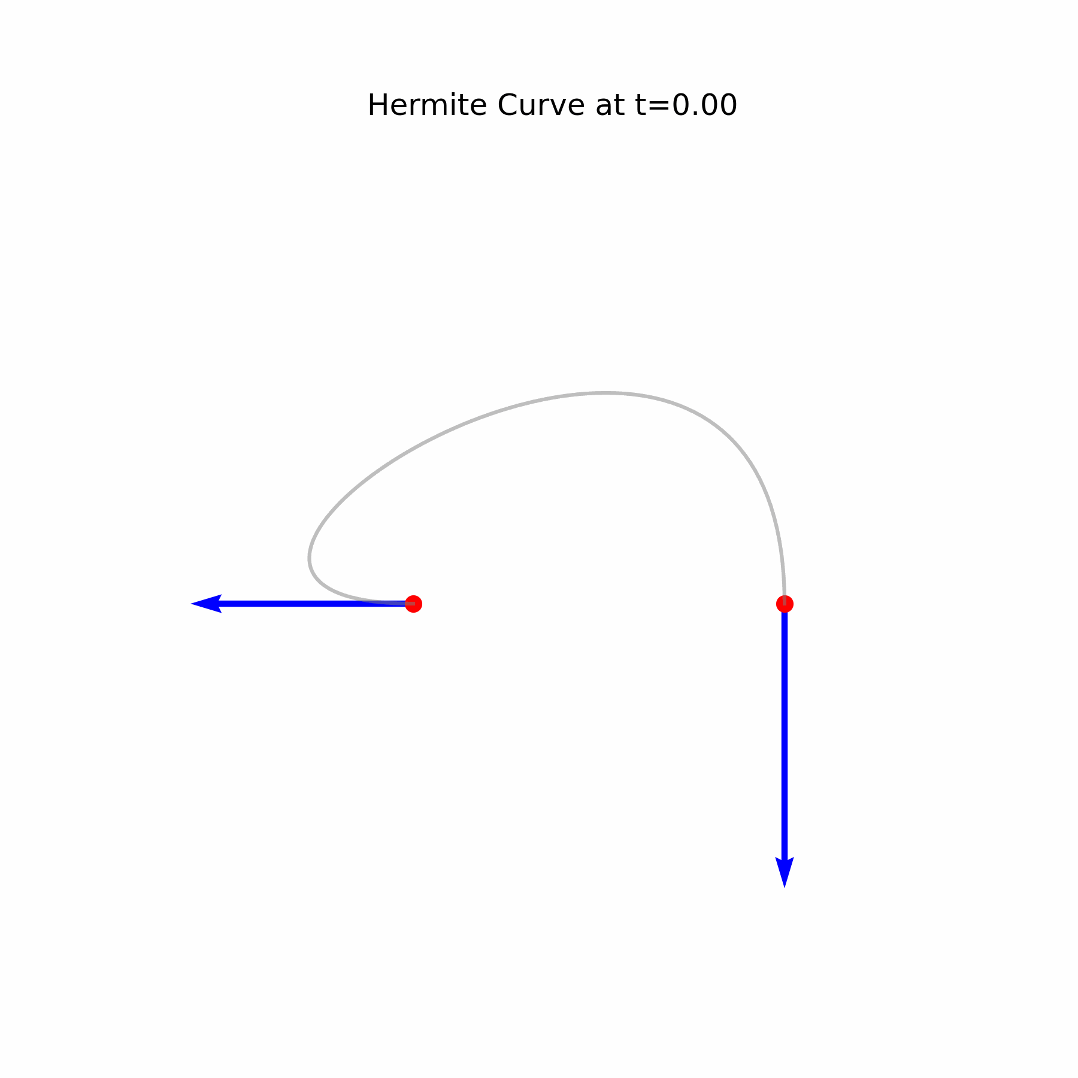
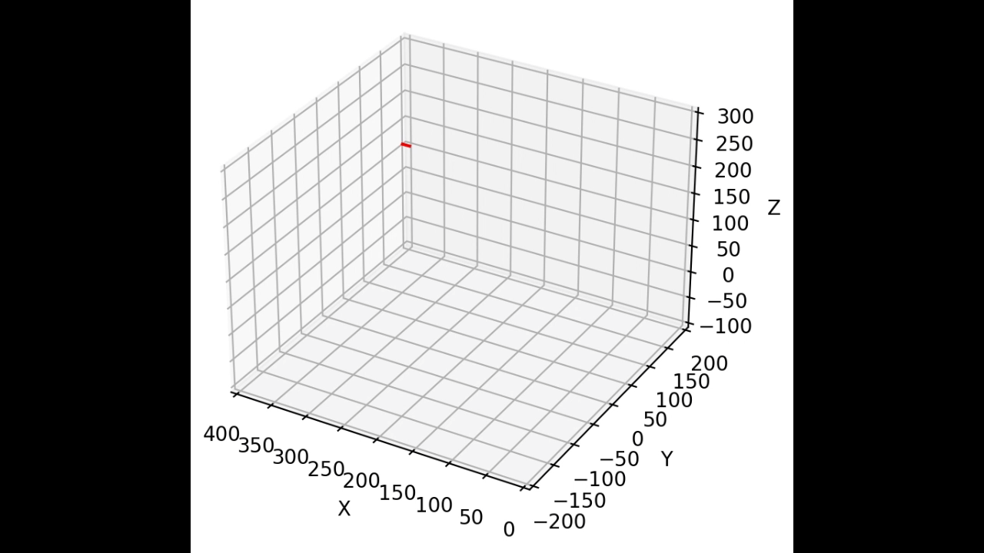
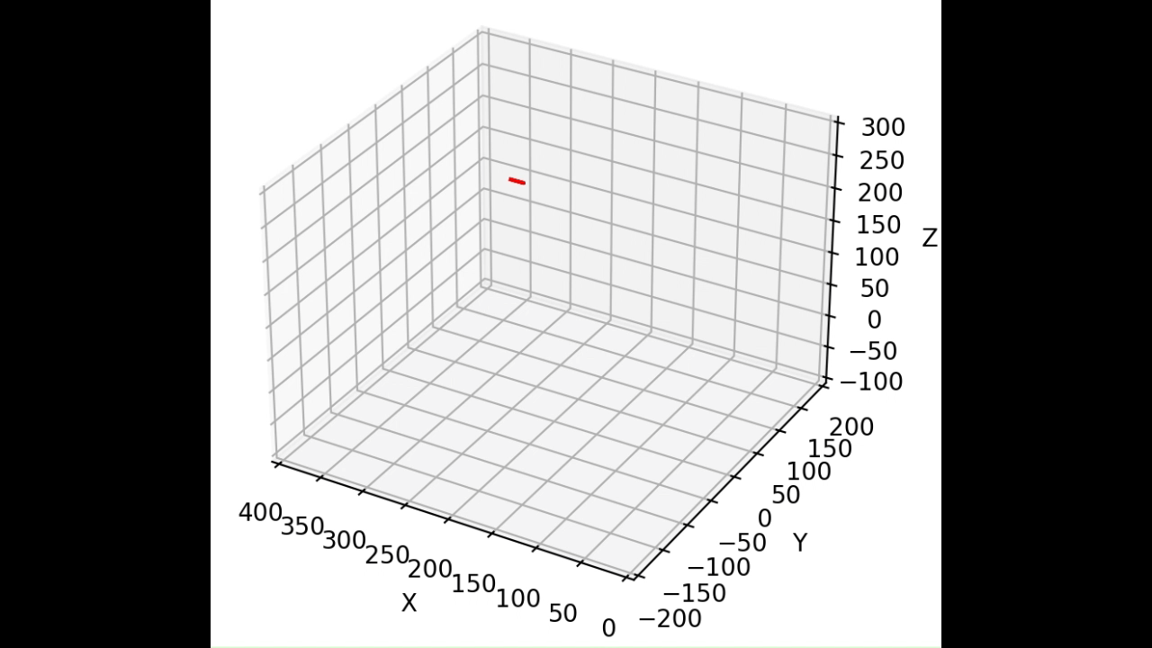
Connecting Hermite Curves
First version for 2D Spline Algorithm
Final version for 3D Spline Algorithm
Notes:
After connecting the control points within a stroke, I added these red connecting Hermite curves to control it to lift up the brush and go to the next stroke. Originally, I uses this Hermite curve that directly goes up and down to connect them. However, the sudden change of direction from going horizontally along the paper to vertically up is not smooth. Therefore, I modified the starting velocity vector into this horizontal along the previous movement direction to make it smoothly lift up the brush with G1 continuity.

Slide 25
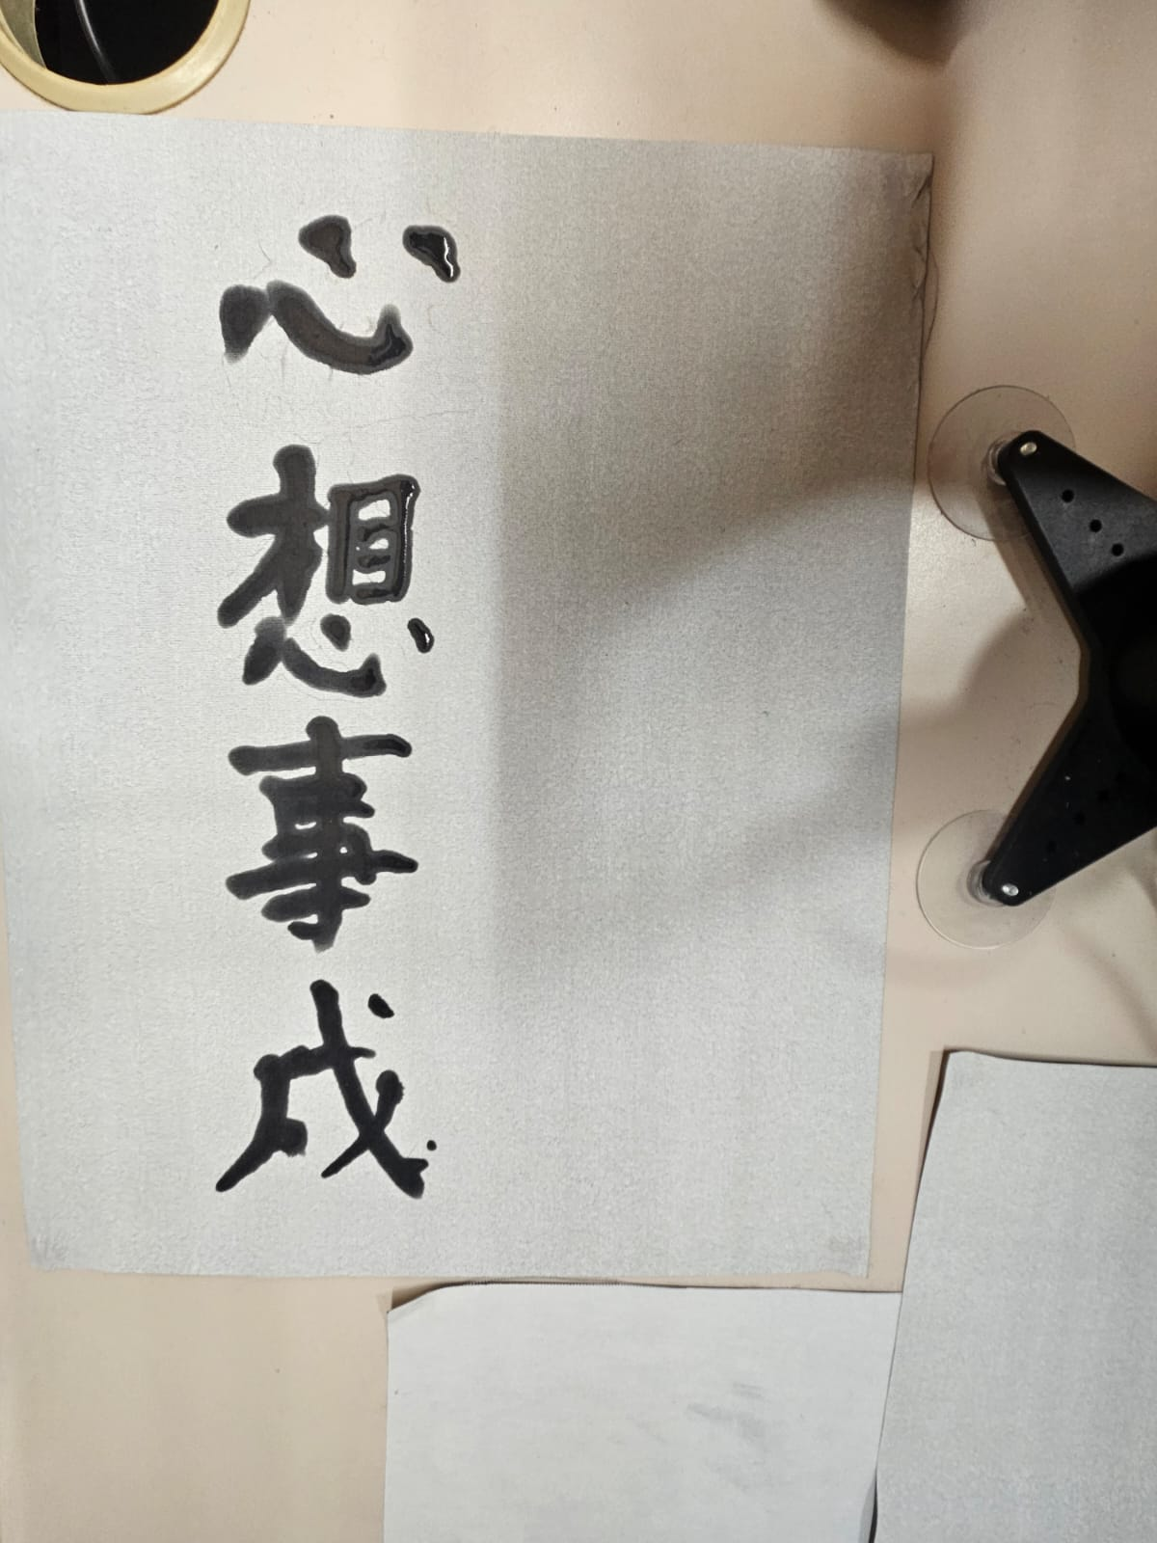
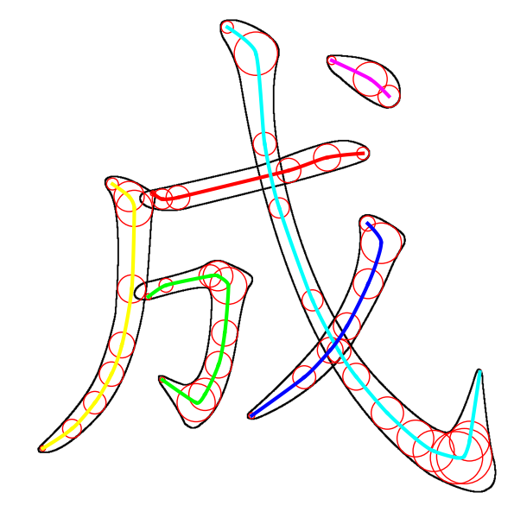
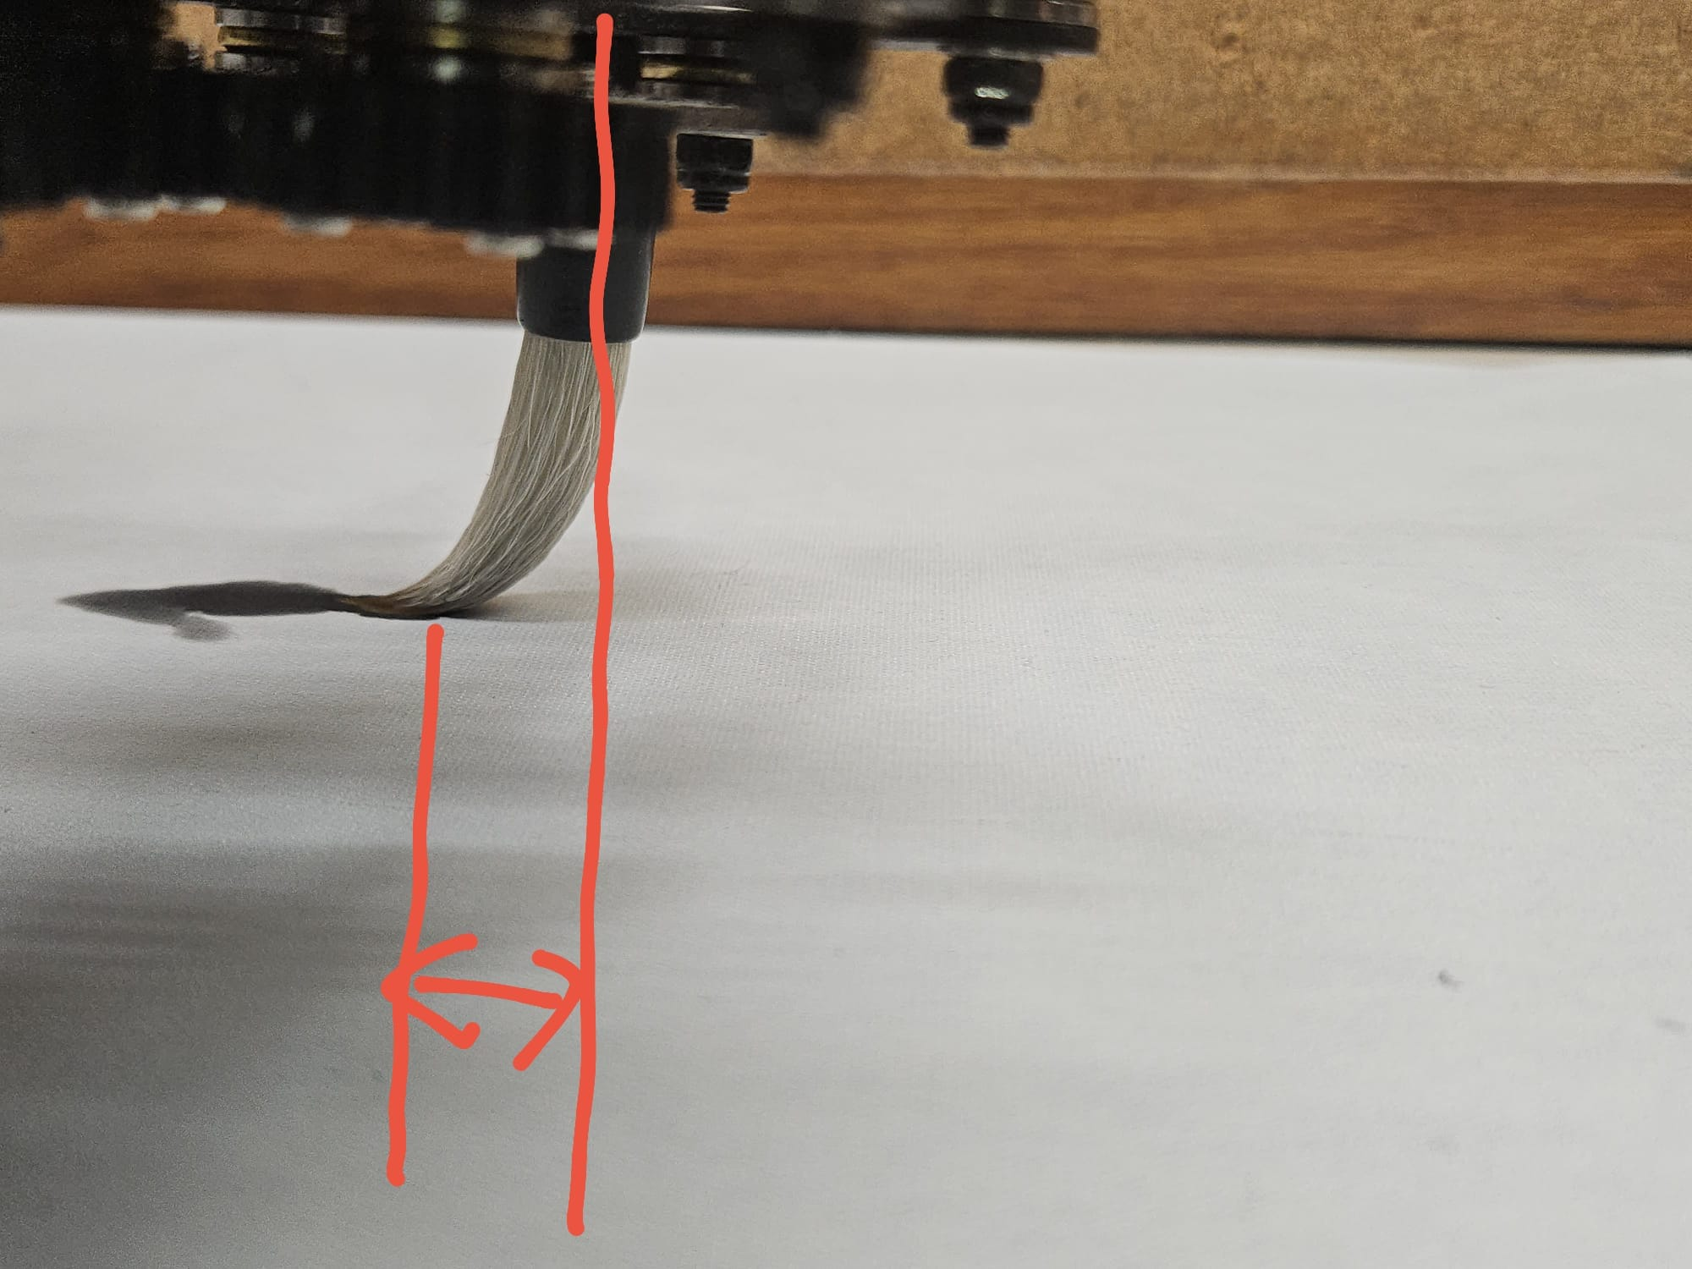
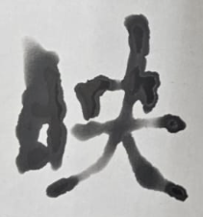
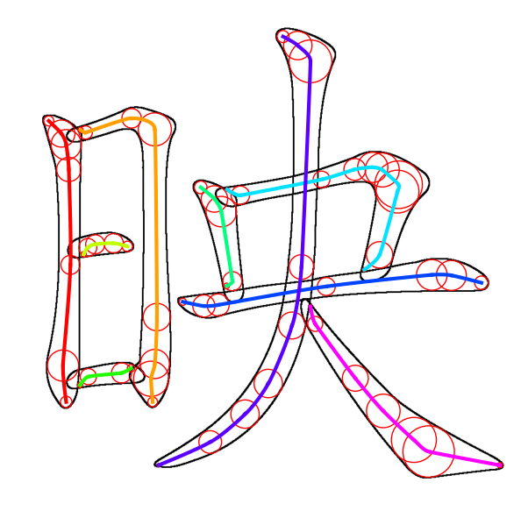
Brush Correction Algorithm*
*Not included in Final Report
ERROR!
Notes:
After some testing, I found that the reason why it can’t write complex strokes clearly is because there is an error distance between the brush body and the brush tip. This cause it to move diagonally when it needs to move in a L shape. I thought of a way to correct this error AFTER I submitted my final report so this is not included in the report.

Slide 26
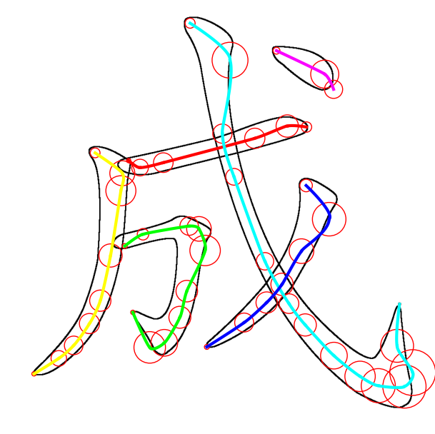
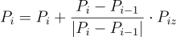
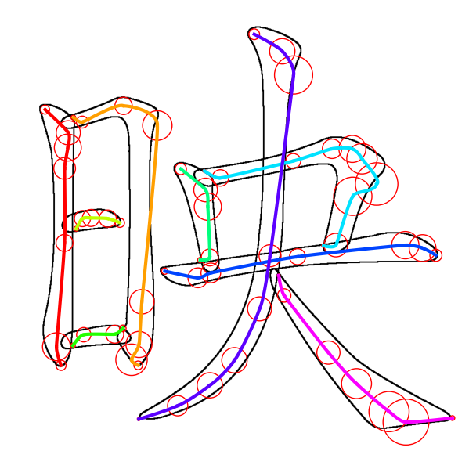
Brush Correction Algorithm*
*Not included in Final Report
Notes:
So, I shift the original control points in the direction from previous point to current point. So, if it is a straight line, the shifted position is still on the line. But if the line is in L-shaped, it would go a little bit outward to compensate the error.

Slide 27
Robot Manipulation
Computer Vision System
Control Point Generation
Trajectory Generation
Robot Manipulation
CNN Model
Fetch 2D Control Points
3D Bézier Splines
Control Robotic Arm
Calibrate Writing Height
Generate 3D
Control Points
Add Connecting
Hermite Curves
Chinese Calligraphy
Notes:
Finally, it’s robot manipulation part.

Slide 28
User Interface
Notes:
I created a simple UI to control the movement of the robotic arm. Users can choose which fai chun they want to write. They can also input their own custom characters.

Slide 29
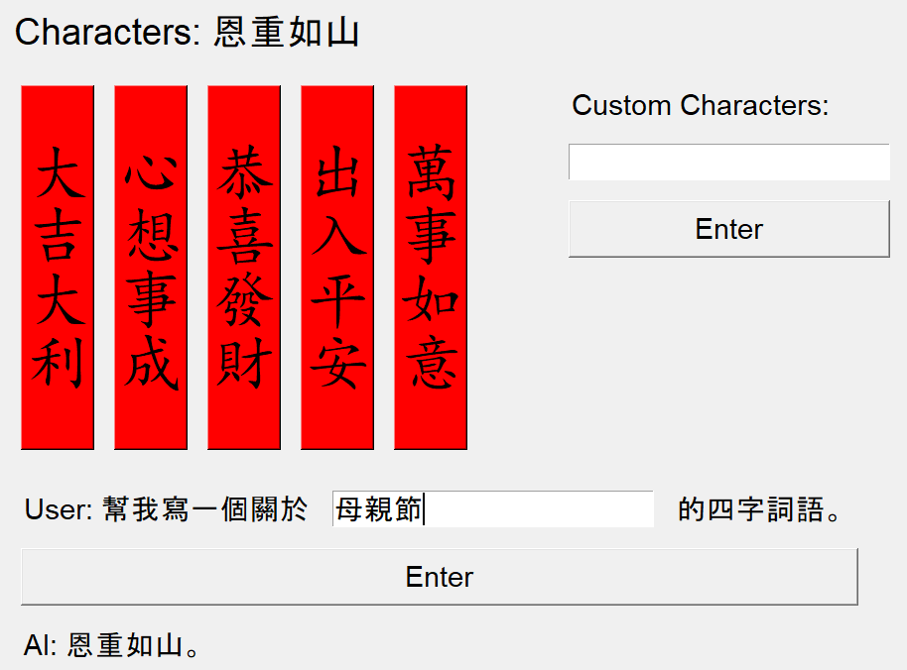


New LLM Feature*
*Not included in Final Report
ChatGPT - 4o
Q: 幫我寫一個
關於春節的四字詞語。
(Help me write a
four-character idiom
related to the
Spring Festival.)
A: 大吉大利
(Great luck
and great profit)
Notes:
After I submitted the Final Report, I added a new LLM Feature by calling the API of HKUST ChatGPT-4o. Users can input a topic or a festival into the prompt and ChatGPT can help you think and input some relevant Fai Chun for the robotic arm to write.

Slide 30
03
PERFORMANCE EVALUATION
How well it works
Notes:
My last objective statement is to evaluate the performance boost of this Bezier curve path planning when compare to traditional methods.

Slide 31
Developed 3 Path Planning Algorithms to compare & evaluate the result
Straight Line
BENCHMARK ALGORITHM
2D Bézier Spline
INTERMEDIATE ALGORITHM
3D Bézier Spline
FINAL ALGORITHM
Notes:
So, I developed 3 different algorithms to compare their performace, which are the straight line benchmark algorithm that connects everything with straight line, the 2D Bezier Spline Algorithm which is a algorithm before I think of the largest fitting circle and the final 3D Bezier spline algorithm.

Slide 32






Straight Line Benchmark Algorithm
Notes:
The Straight line algorithm directly uses the fetched control points and connect them with straight line. This can act as a benchmark to evaluate other algorithms.

Slide 33






2D Bézier Spline Intermediate Algorithm
Notes:
2D Bezier Spline algorithm add a fixed height for the control points. So, the result has relatively uniform thickness.

Slide 34









3D Bézier Spline Final Algorithm
Notes:
The final 3D Spline Algorithm has varying height, which creates varying brush thickness in the written words.

Slide 35


44.53%
41.66%
Comparison Data
Faster for 2D Spline than Straight Line
Faster for 3D Spline than Straight Line
Notes:
I tested all 3 algorithms on many different characters and Fai Chuns and I recorded their time. The 2D Spline Algorithm is 44.53% faster than Straight Line Benchmark and 3D Spline is 41.66% faster

Slide 36
04
VIDEO DEMO
How well it works
Notes:
My last objective statement is to evaluate the performance boost of this Bezier curve path planning when compare to traditional methods.

Slide 37

Demo in FYP Industry Day
Notes:
Here is a Demo in FYP Industry Day.

Slide 38

THANKS
Computer Vision-based Path Planning for Robot Manipulator Using Bézier Curves
CHEUNG Dick Ho (WKT06a-24)
Supervisor: Professor Tim Woo
Notes:
And this is a timelapse of my FYP Industry day.

Slide 39
Questions & Answers

